Slide 1
Shopster
One-stop for head to toe look

Slide 2
Introduction
As we know, there are very few in-demand websites out there that offer online services to deliver various products in Pakistan. For the most part, we refer to these websites as E-commerce websites.
Since there are very few websites out there, we are going to build an E-commerce website that has become very advantageous nowadays due to COVID. Most people prefer to buy products online by visiting different E-commerce websites.

Slide 3
Our Services
Book Store
Men & Women Fashion
Computer gadgets
Mobile
Grocery Items
Kids & Fun
Electronic Appliances
Pharmacy
Arts & Crafts
General Items

Slide 4
What project is about?
Our project is about an E-commerce Website where a user can come and buy different products/items that belongs to different categories and we facilitate the user to Login and Signup using Custom Email address and we’ve multiple categories where user can browse and find the related items. If anyone wants to sale their product through our website(Shopster) then it’s a great opportunity for them and We welcome both the buyers and sellers. If anyone has a query then they can contact Us by just submitting the query and if someone wants to read the policies about Selling products, Building an Online store, about safe payments, delivery policies etc, then we’ve multiple pages for each one of the topics and each page contain the policies of respective heading…

Slide 5
Group Members
Mohib Ismail (CS201063)
Muhammad Hassan (CS201071)
Muhammad Arbaz (CS201068)
Muhammad Haziq (CS201059)

Slide 6
Work Overview
Mohib has done All the HTML, CSS & JS of all 5 pages which includes Home page, Signup & Login page, Contact Us & Order Form. Authentication is also done using Browser’s Local Storage.
Hassan has done all the content writing pages(7 pages) of the website along with FAQ page and Sponsor page and has also Used JS in FAQ page.
Arbaz has Done About Us page and 4 category pages which includes About Us page Men & Women Fashion Page, Kids & Fun page, Pharmacy page, Grocery Items page.
Haziq has done the rest of the 6 pages of the category which includes Book Store page, Computer Gadgets page, Mobile Page, Electronic Appliances page, Arts & Crafts page, General Items

Slide 7
Distribution Of Work
Mohib Ismail
Muhammad Hassan
Website’s Home page
Signup page
Login Page
Contact Us Page
Order Form page
FAQ page
Sponsor page
Sell your product page
Broadcast your product page
Build Online Store page
Delivery Policy page
Return & Replacement page
Your Orders page
About Payments page

Slide 8
Distribution Of Work
Muhammad Arbaz
Muhammad Haziq
About Us page
Men & Women Fashion Page
Kids & Fun page
Pharmacy page
Grocery Items page
Book Store page
Computer Gadgets page
Mobile Page
Electronic Appliances page
Arts & Crafts page
General Items

Slide 9
Extra Work we’ve done!
We’ve extensively used FLEXBOX in our website.
We’ve a Signup and Login Functionality in our website (Using Browser’s Local Storage).
We’ve used KEYFRAME in our website for the little animation.
Each Form in Our website has JS on it.
We’ve also done Web hosting of our website - shopster-168.netlify.app

Slide 10
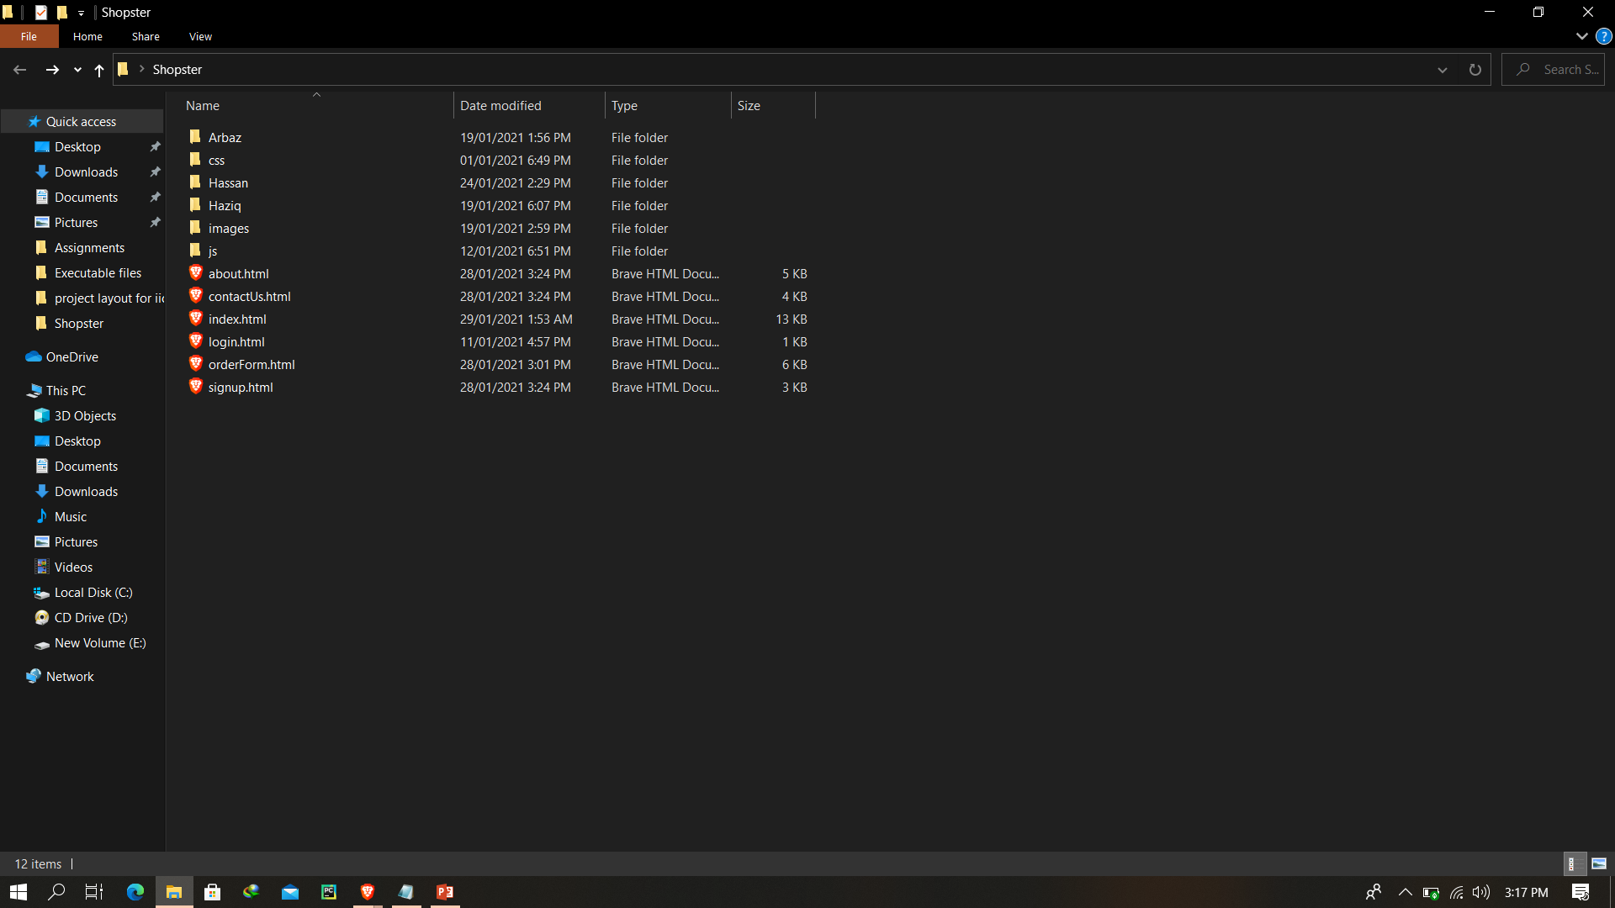
Root directory

Slide 11
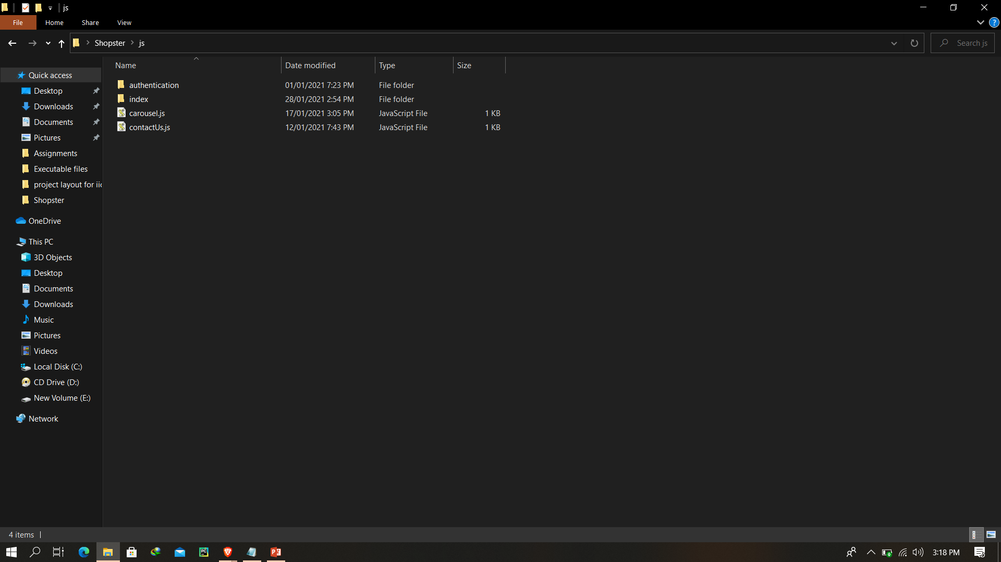
Mohib Folder (JS)

Slide 12
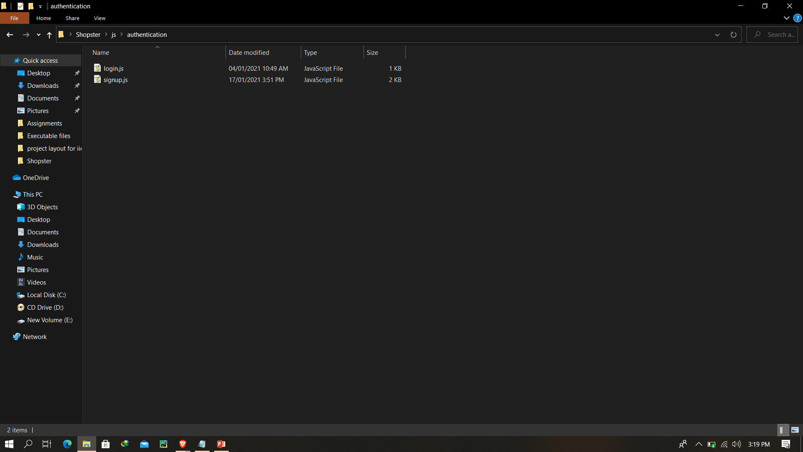
Authentication Folder (JS)

Slide 13
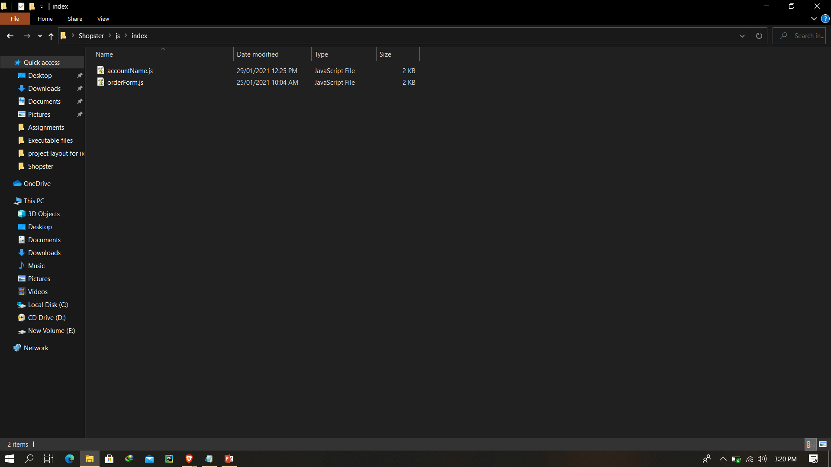
Index Folder (JS)

Slide 14
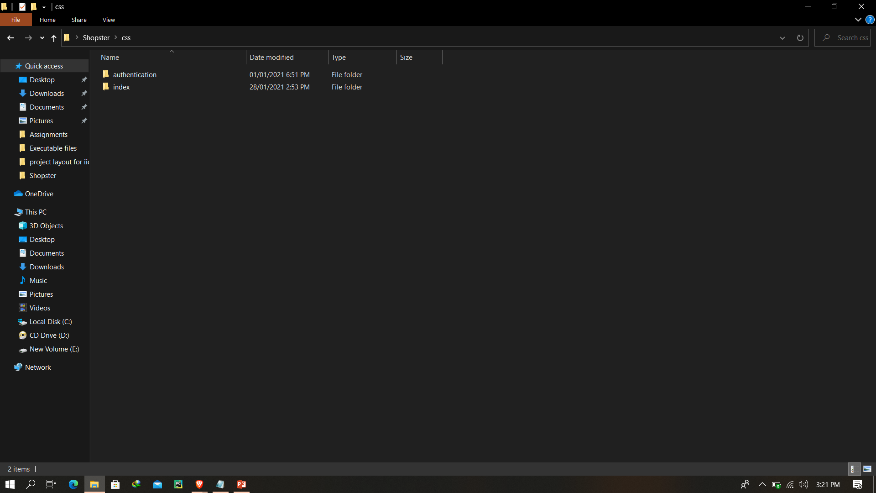
Mohib Folder (CSS)

Slide 15

Authentication Folder (CSS)

Slide 16
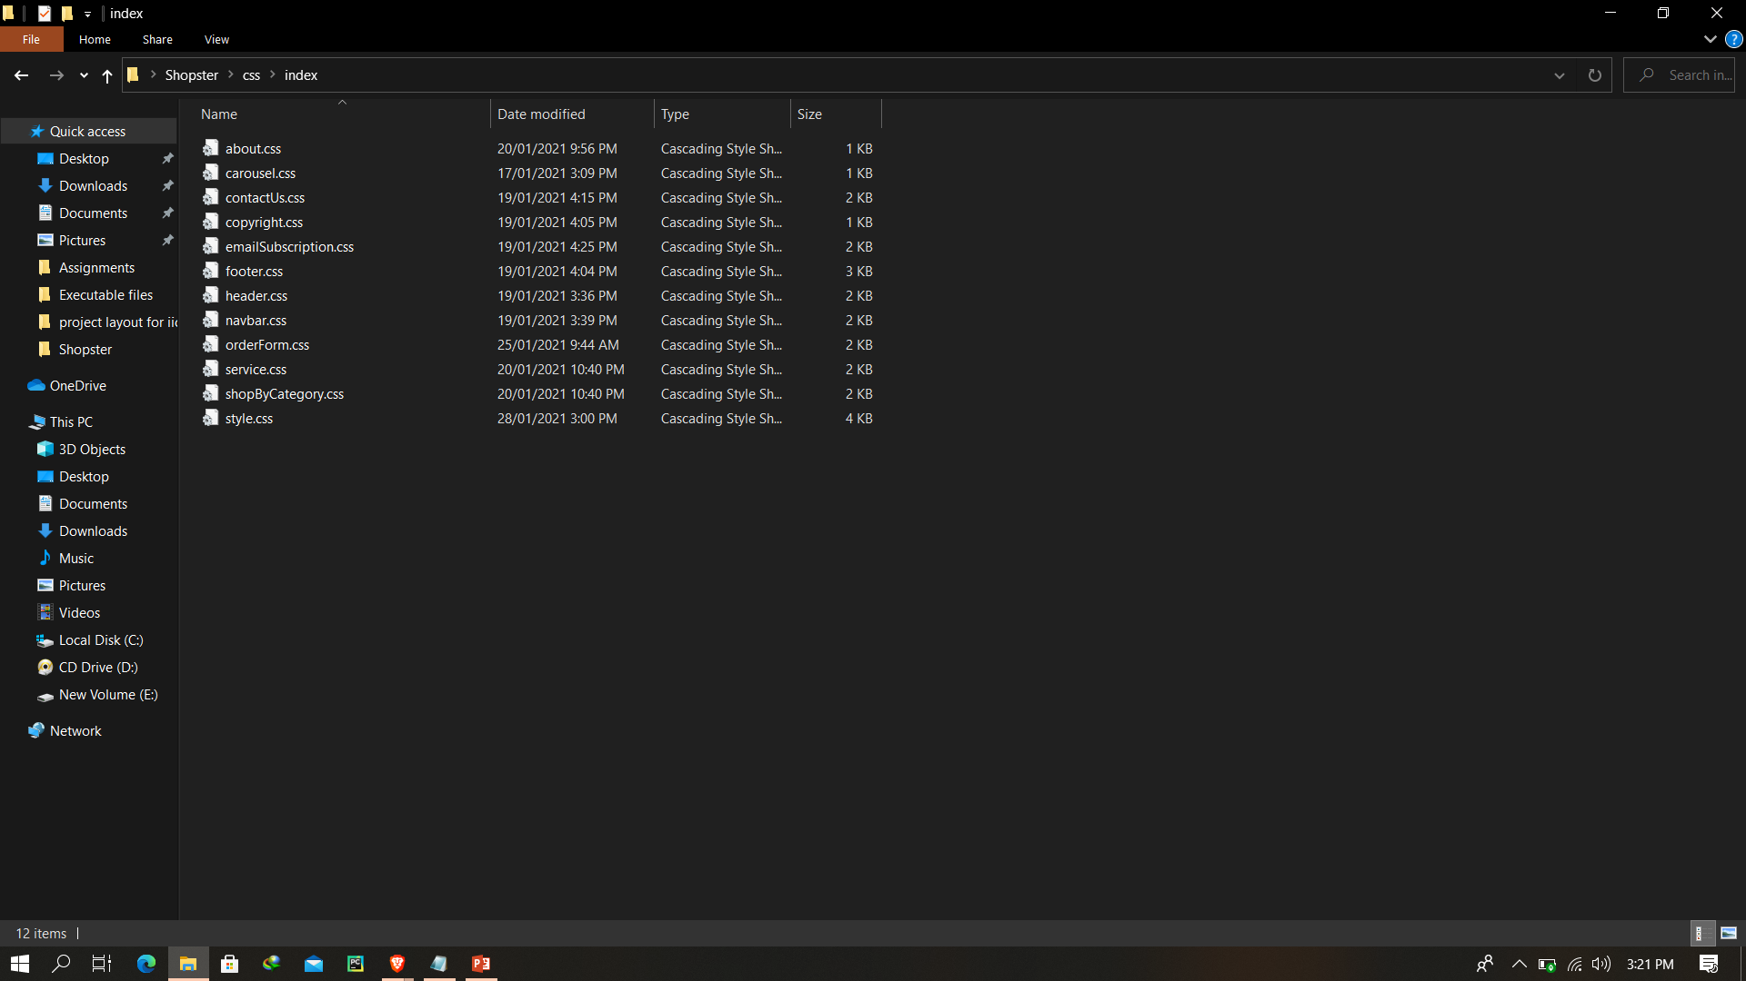
Index Folder (CSS)

Slide 17
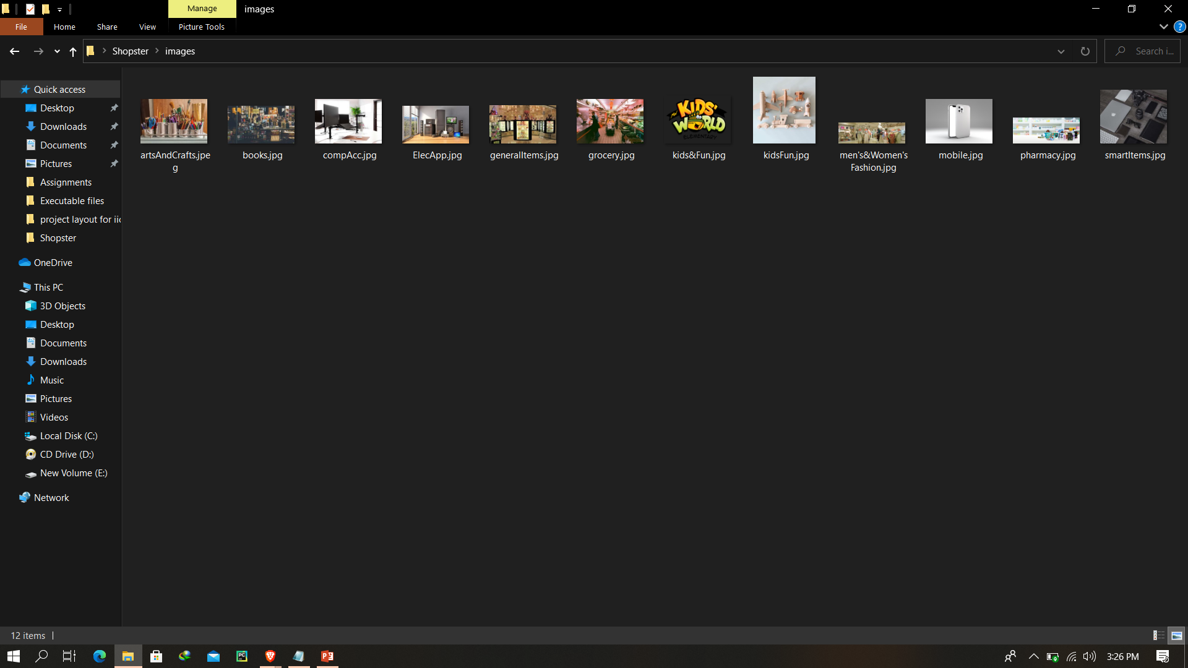
Mohib Images Folder

Slide 18
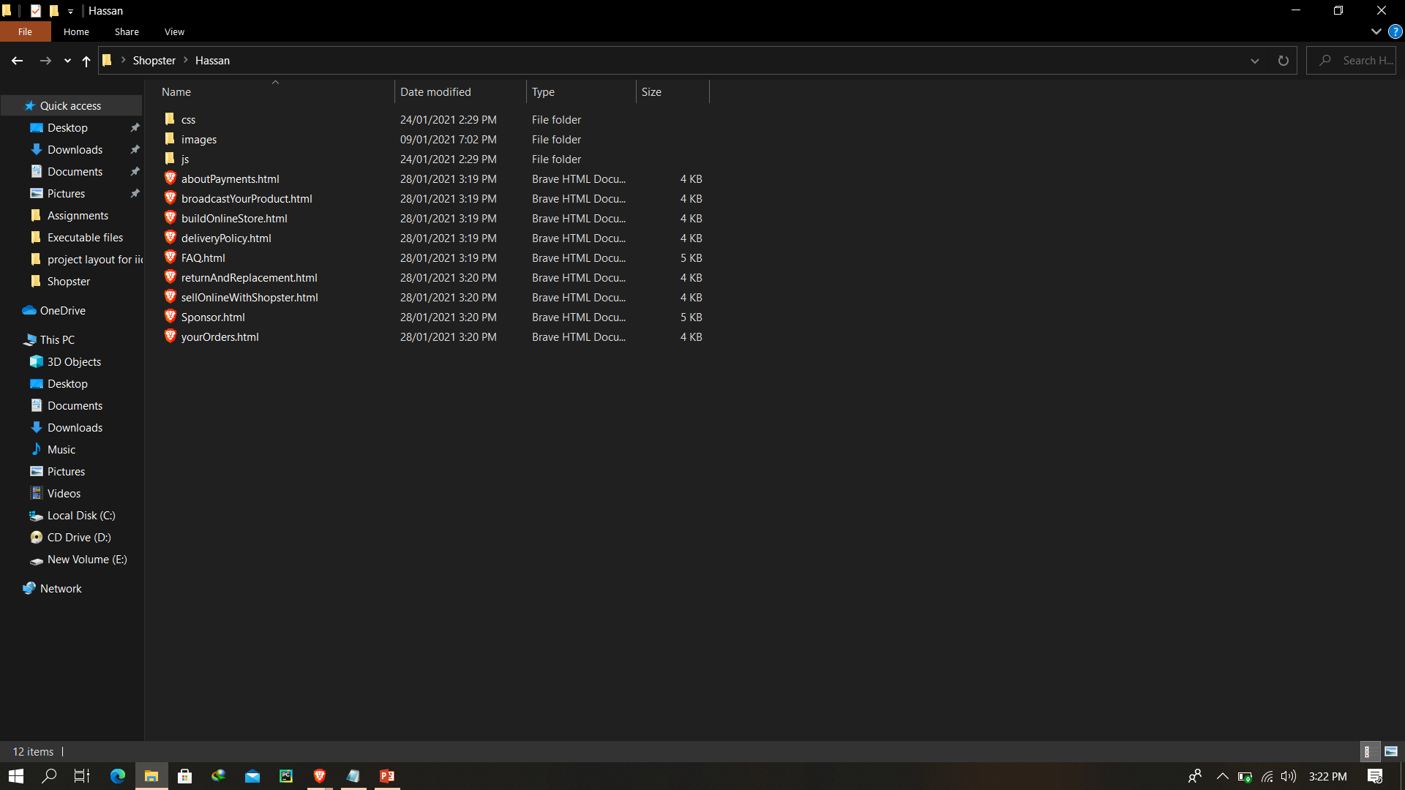
Hassan Folder

Slide 19
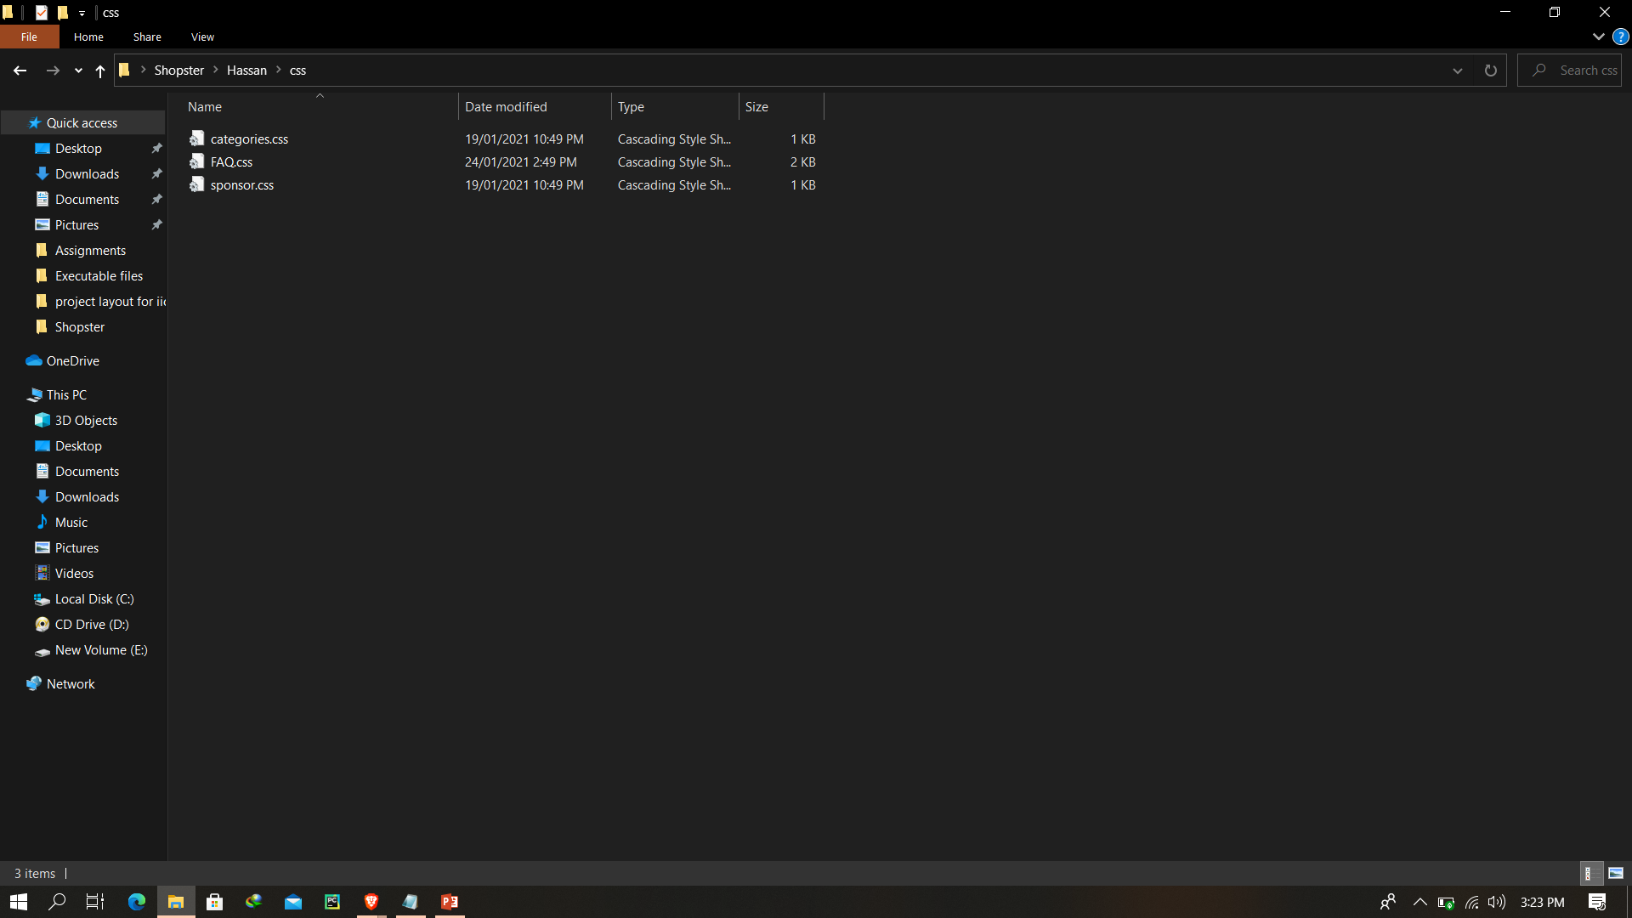
Hassan Folder (CSS)

Slide 20
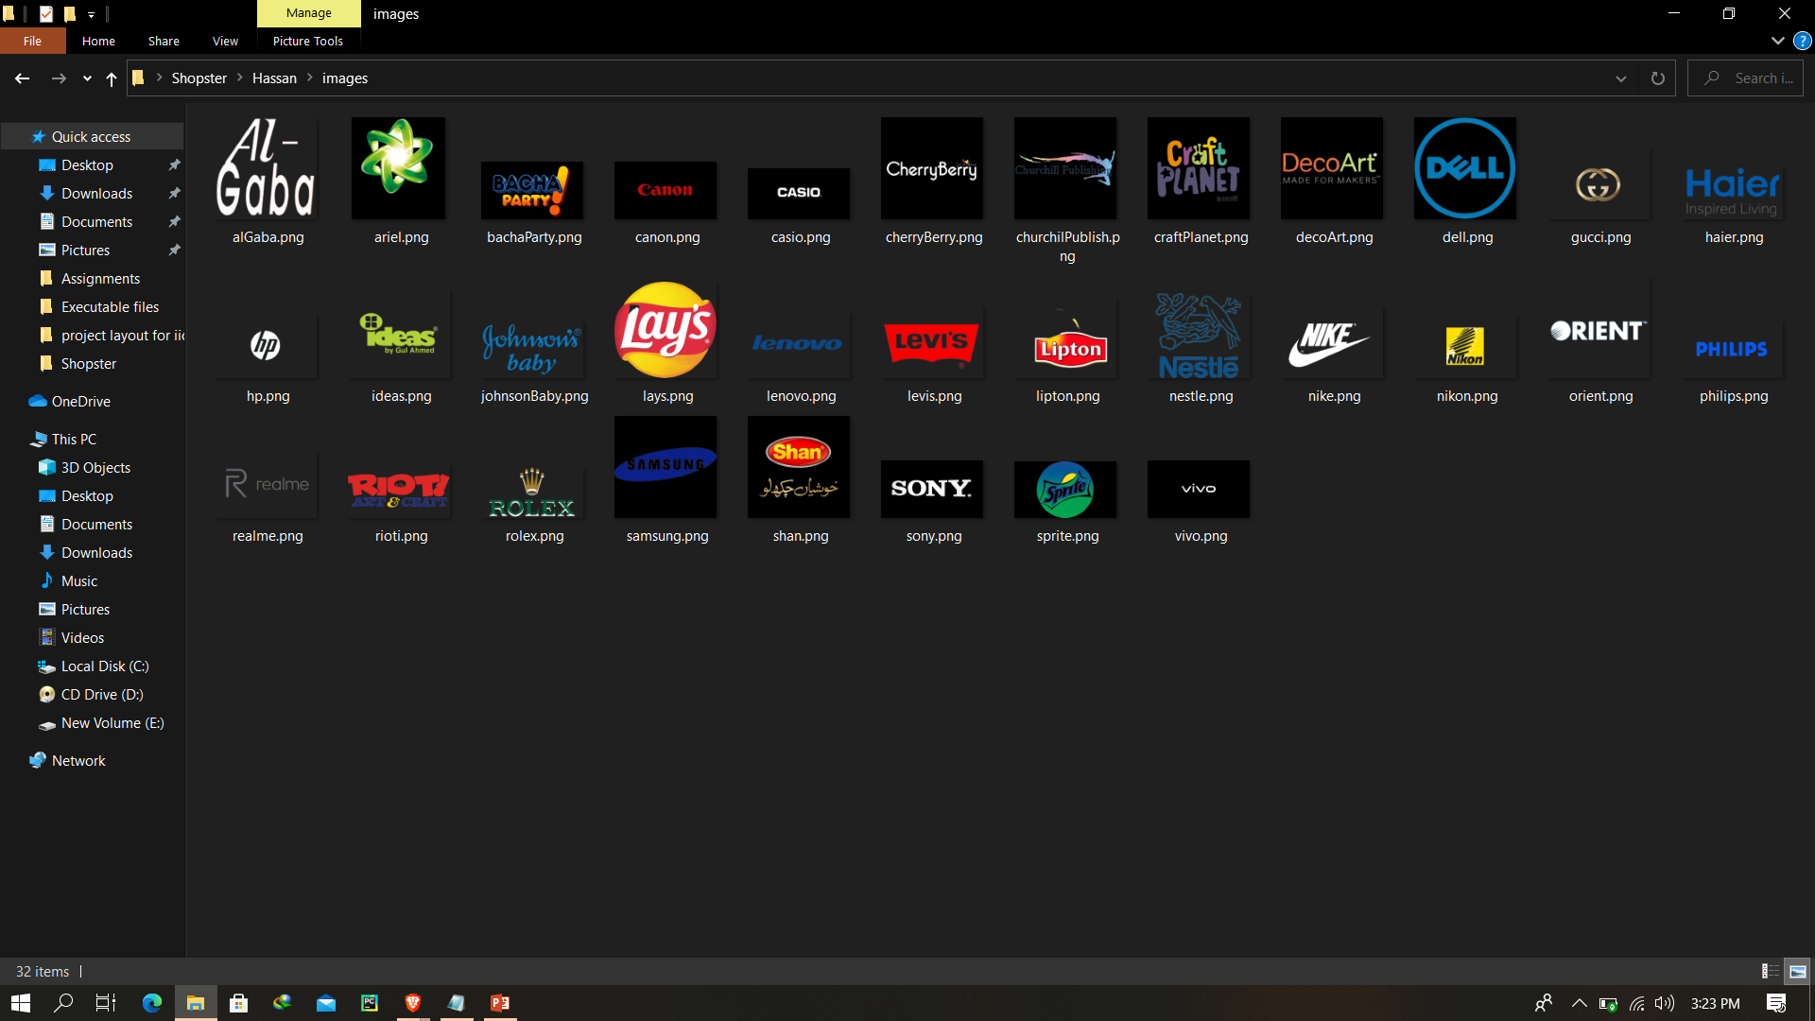
Hassan Images Folder

Slide 21

Hassan Folder (JS)

Slide 22
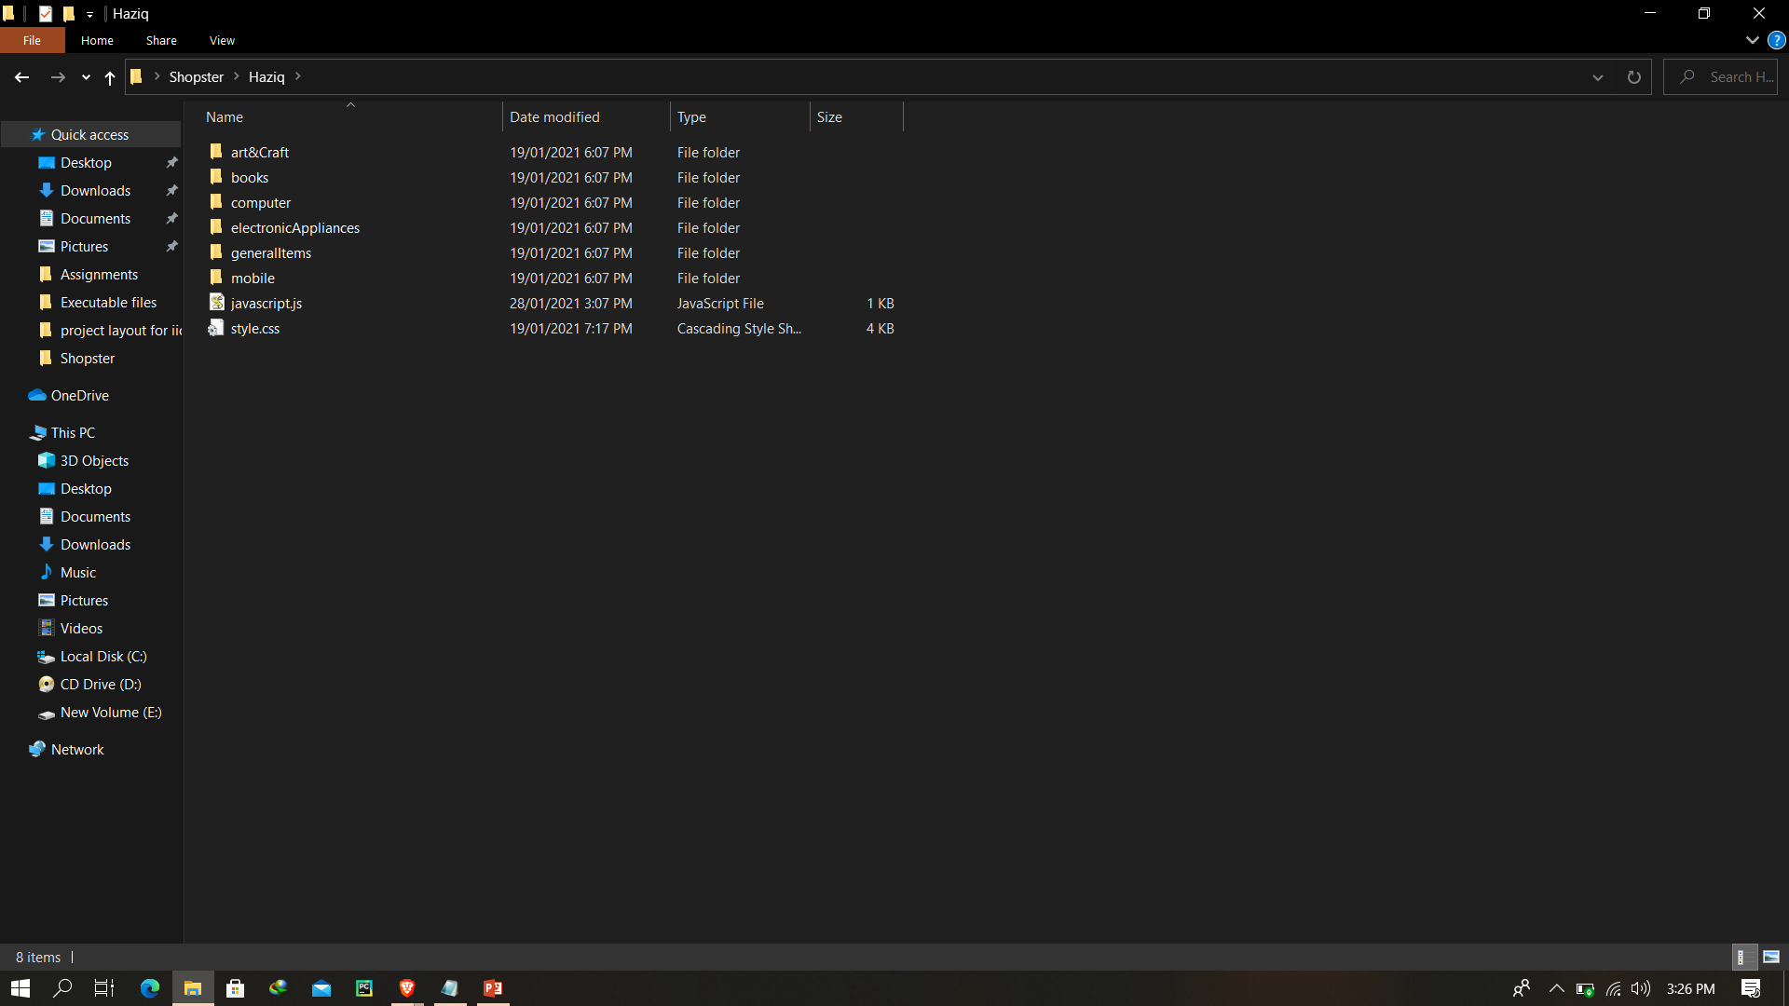
Haziq Folder

Slide 23
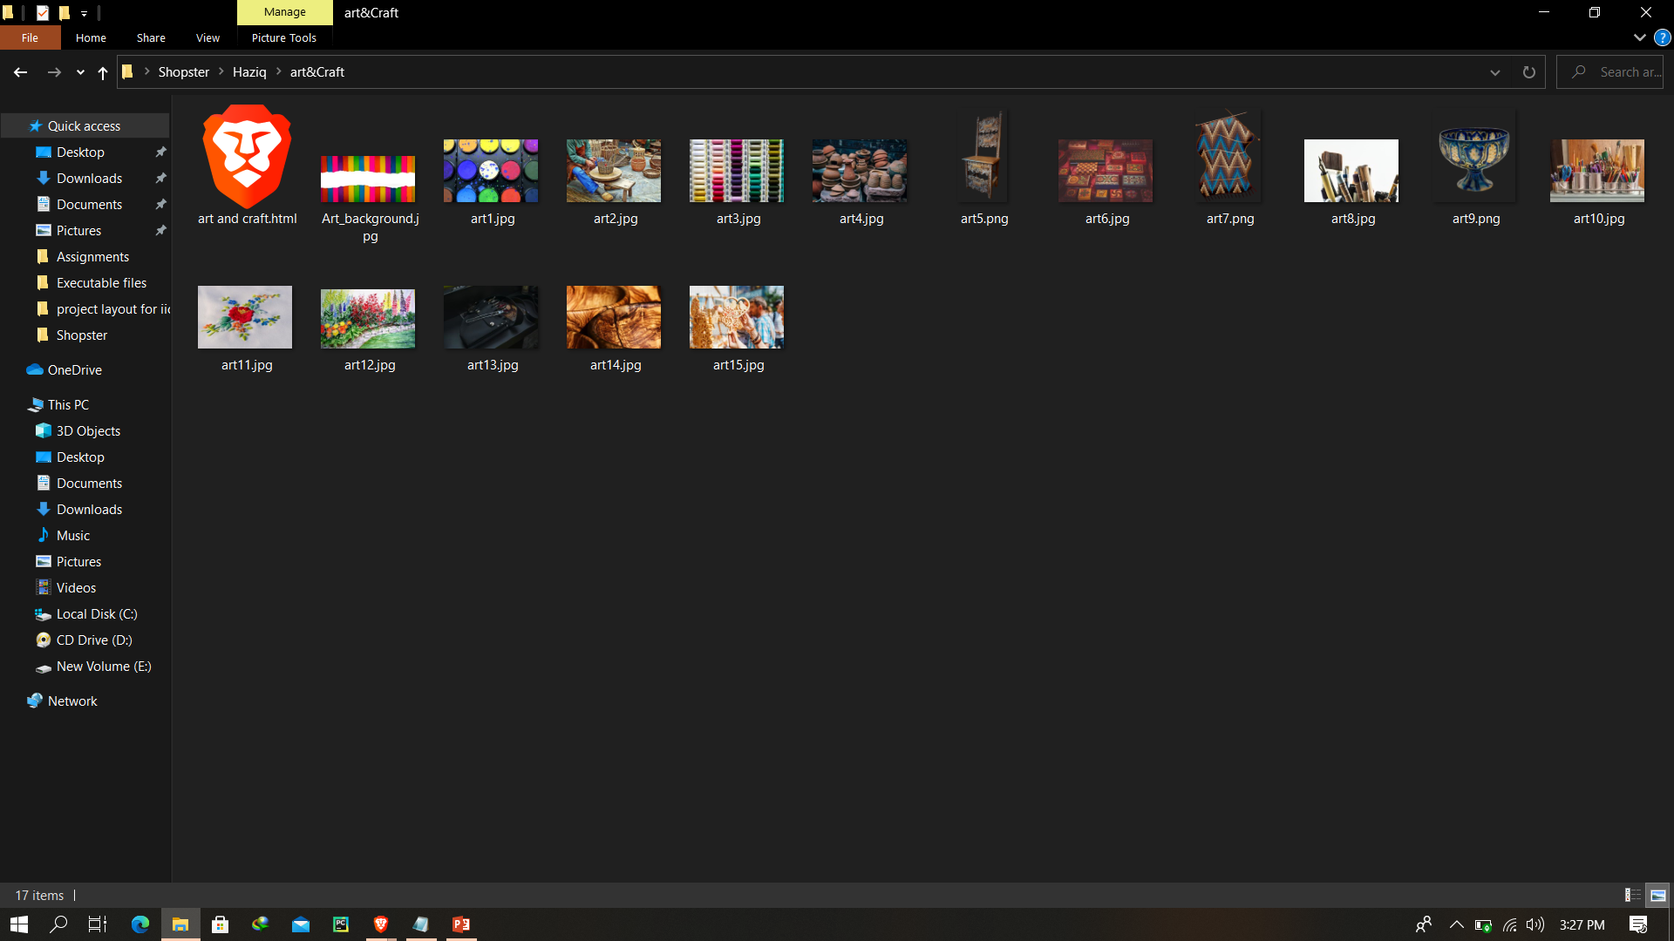
Art & Craft Category

Slide 24
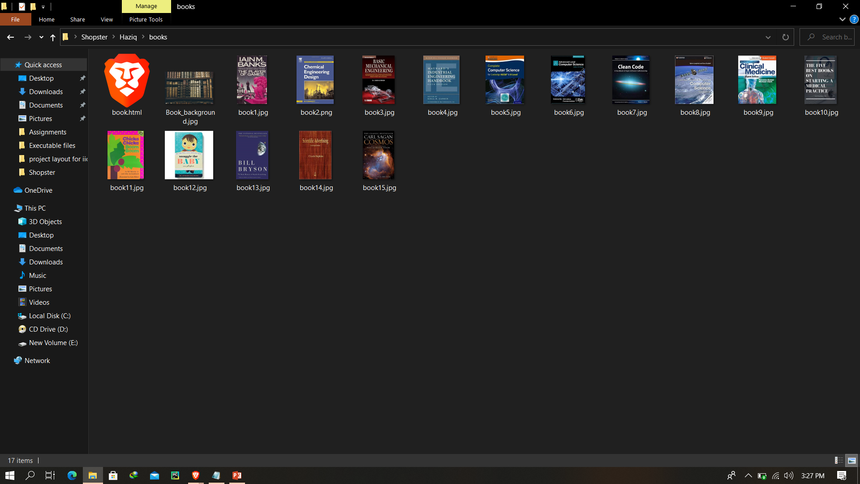
Books

Slide 25
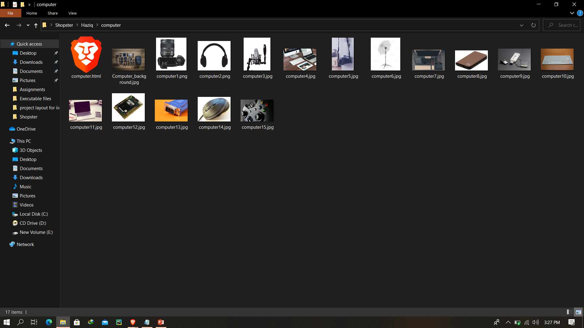
Computer Gadgets

Slide 26
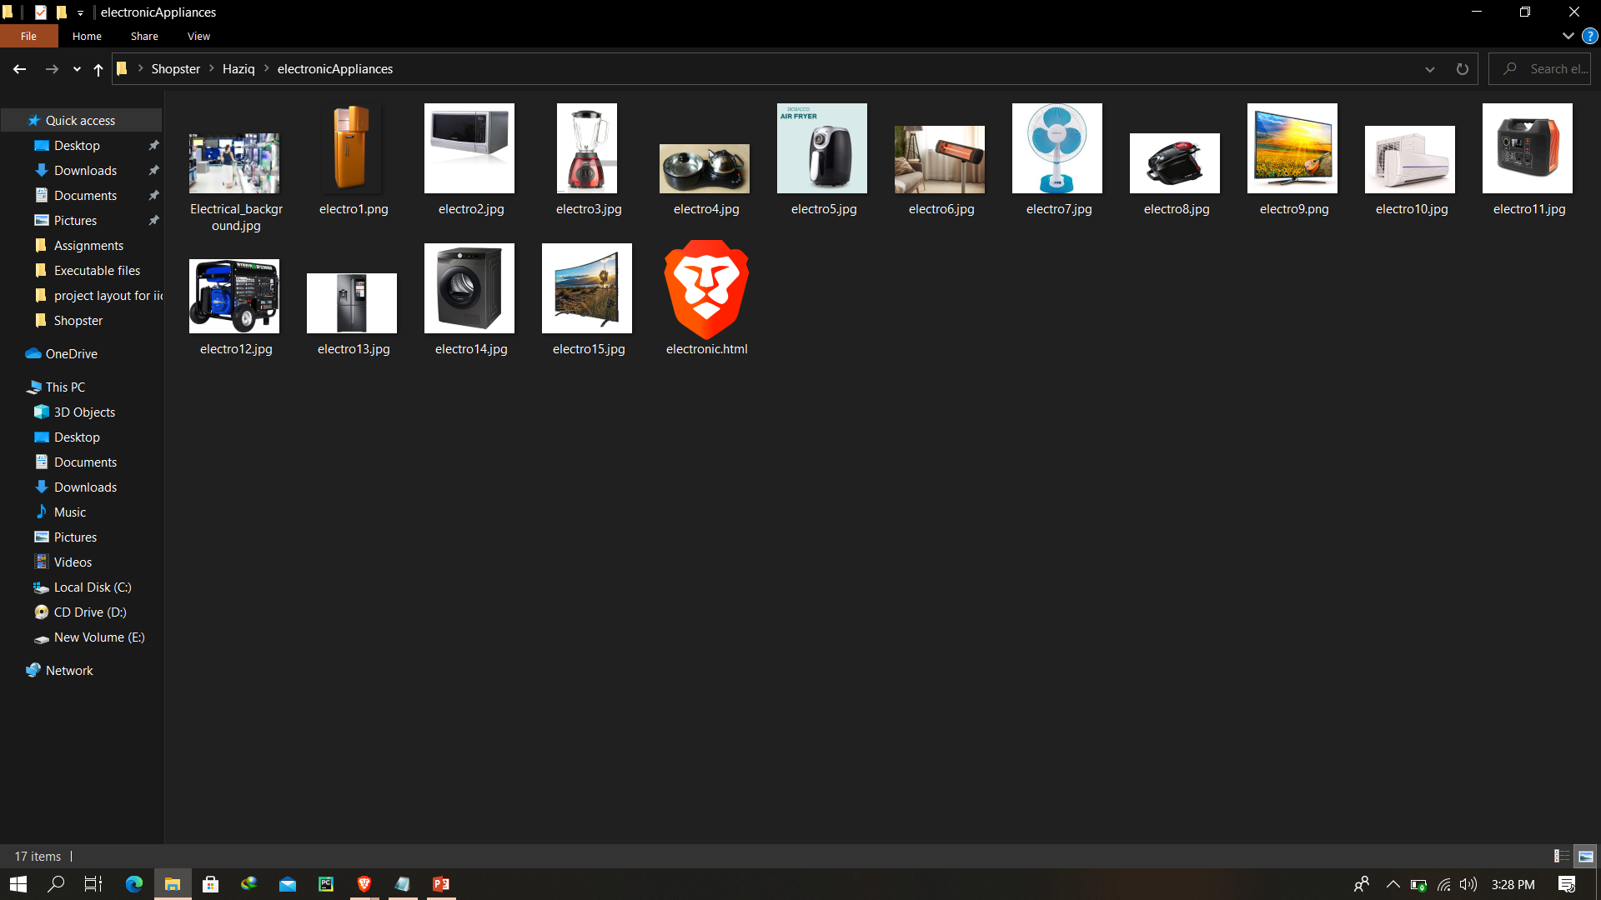
Electronic Appliances

Slide 27
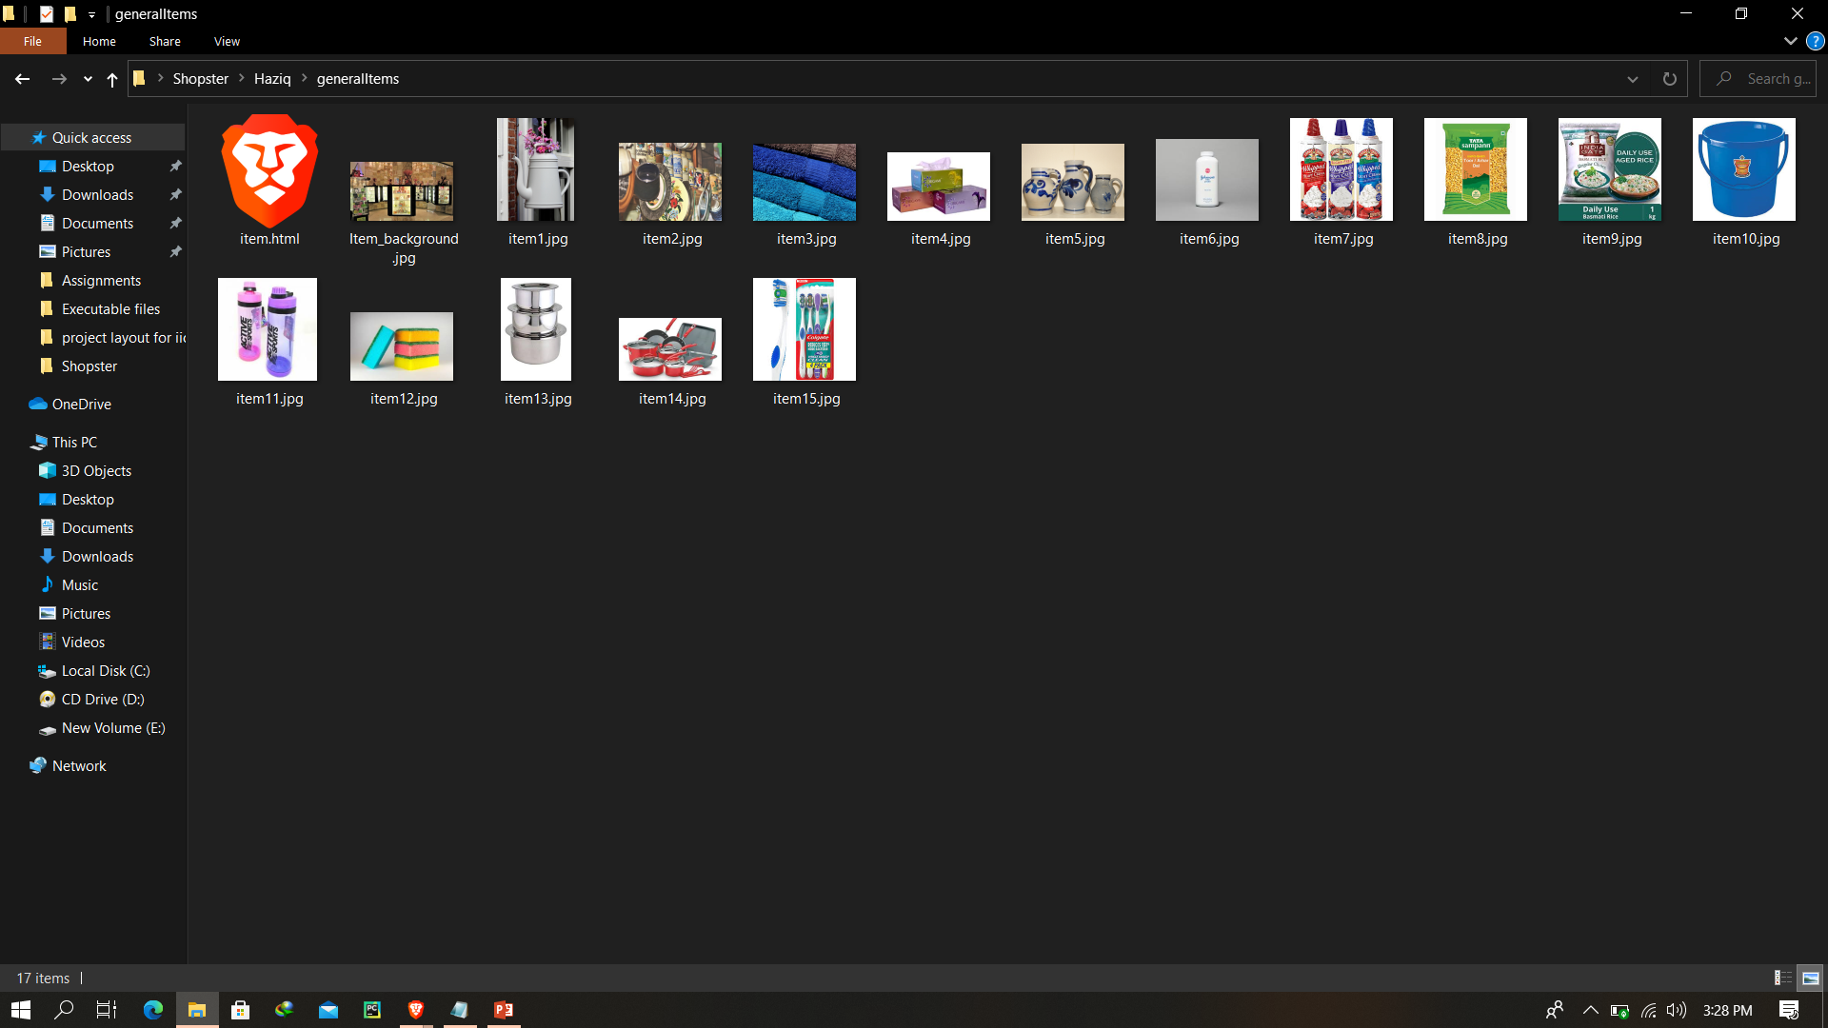
General Items

Slide 28
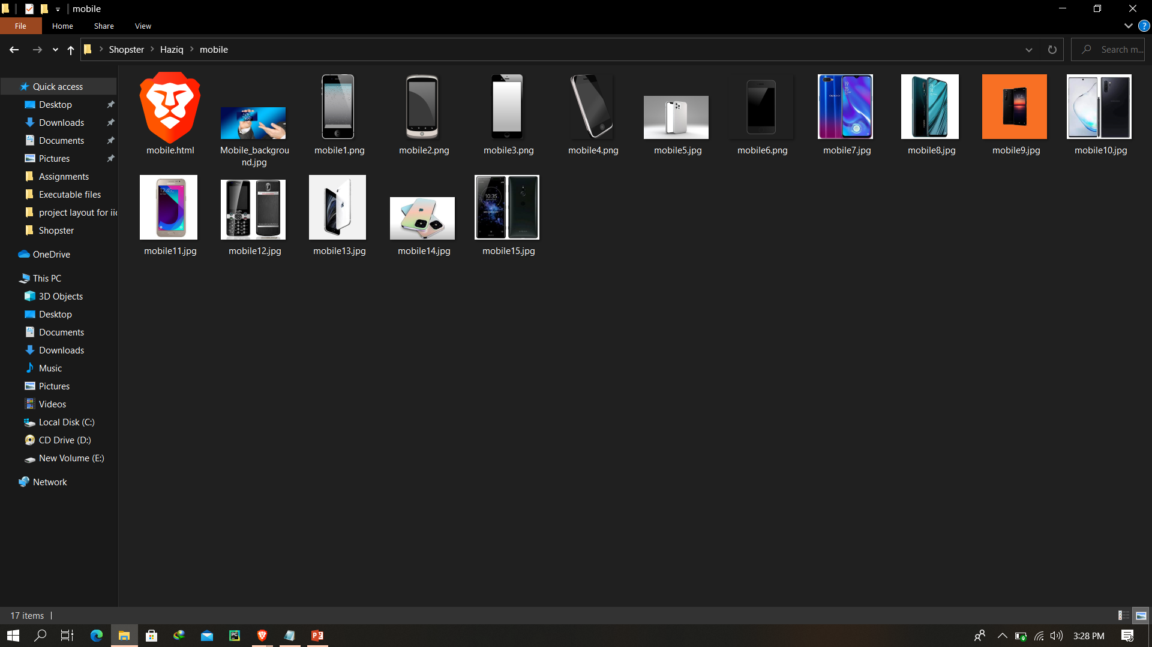
Mobile

Slide 29
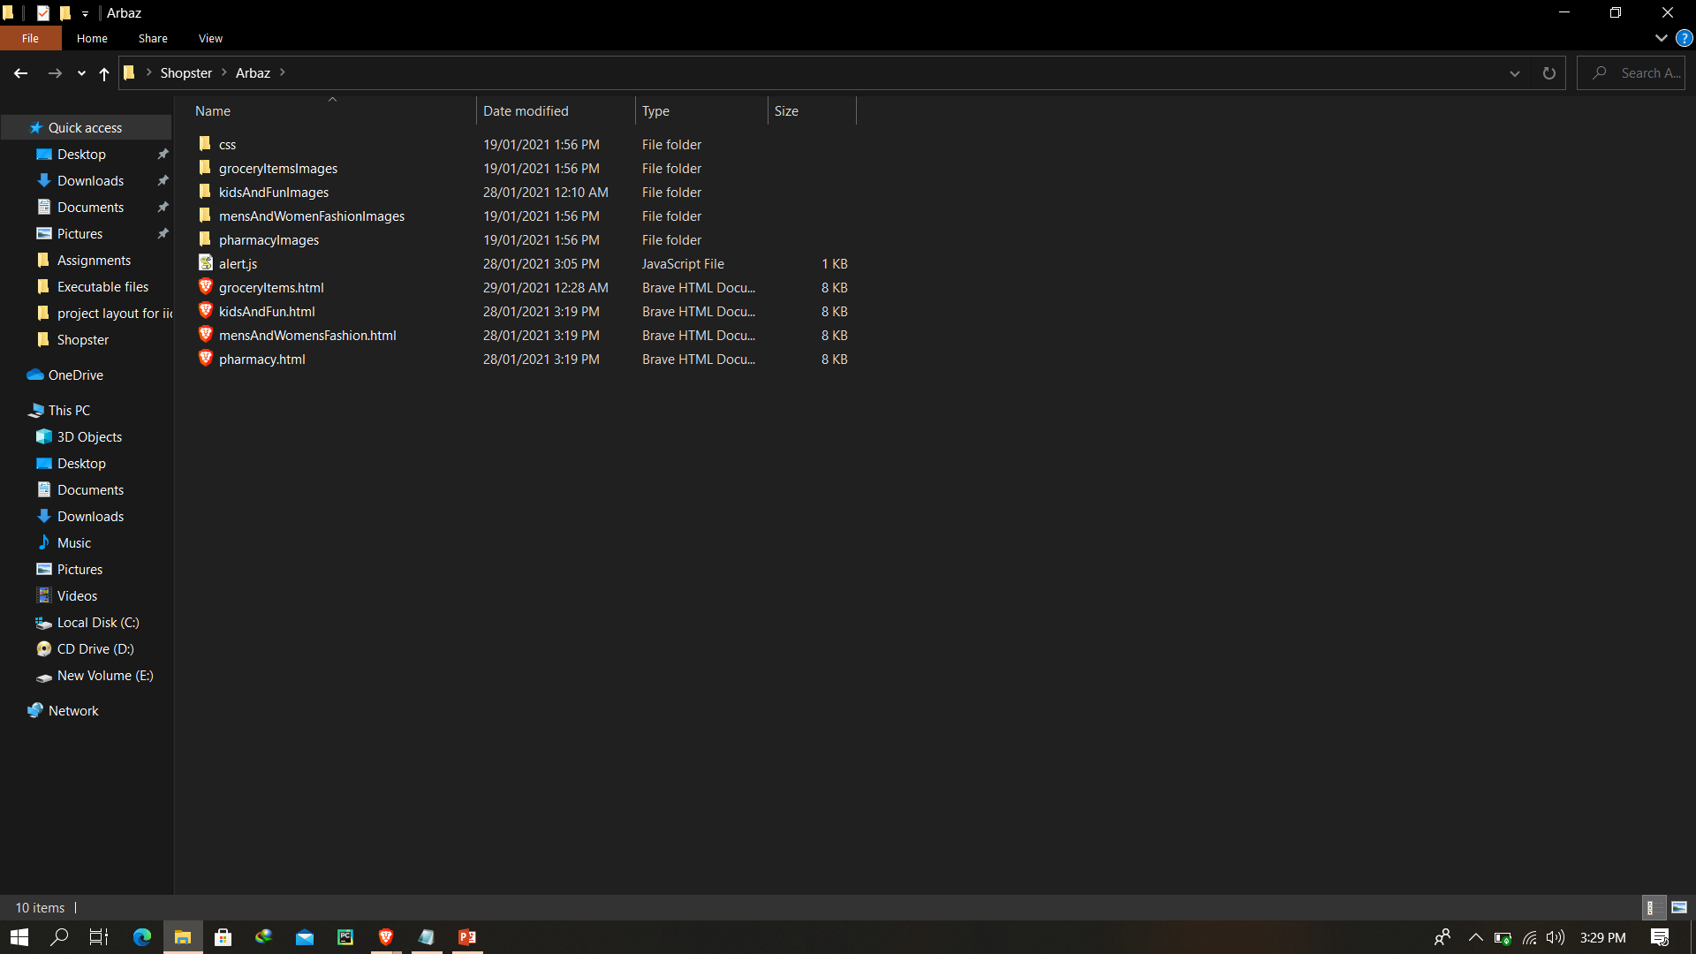
Arbaz Folder

Slide 30
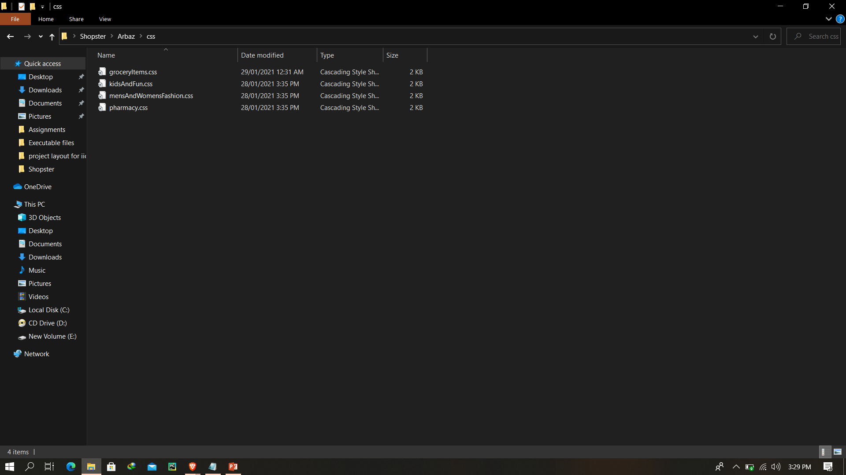
Arbaz Folder (CSS)

Slide 31
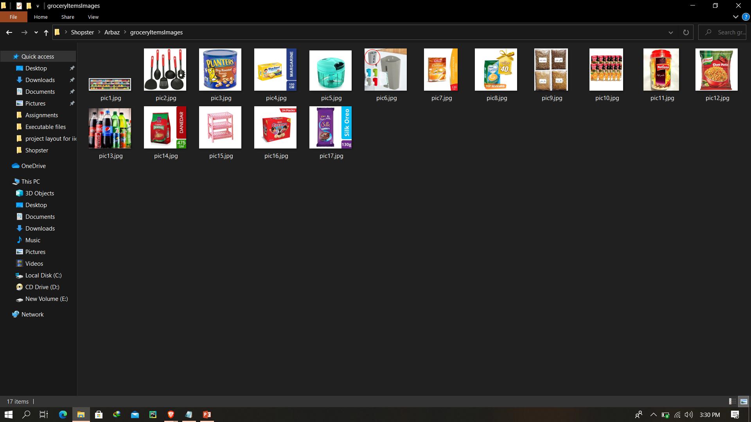
Arbaz Images Folder (Grocery)

Slide 32
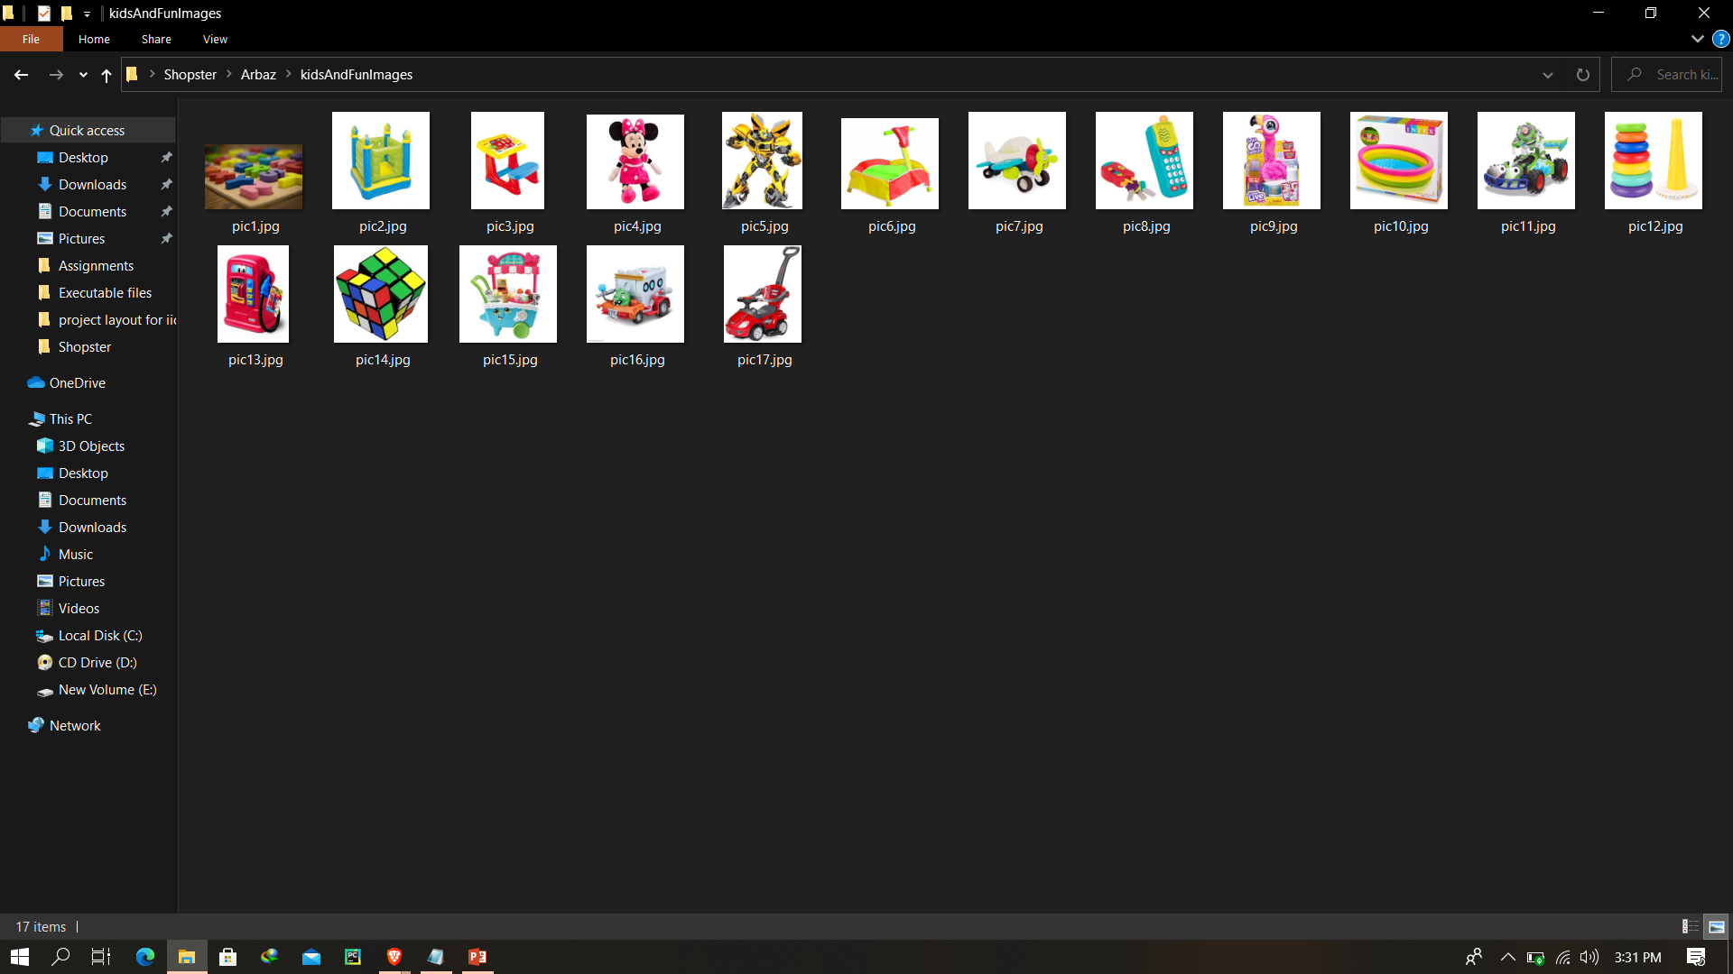
Arbaz Images Folder (Kids & Fun)

Slide 33
Arbaz Images Folder (Men & Women Fashion)

Slide 34
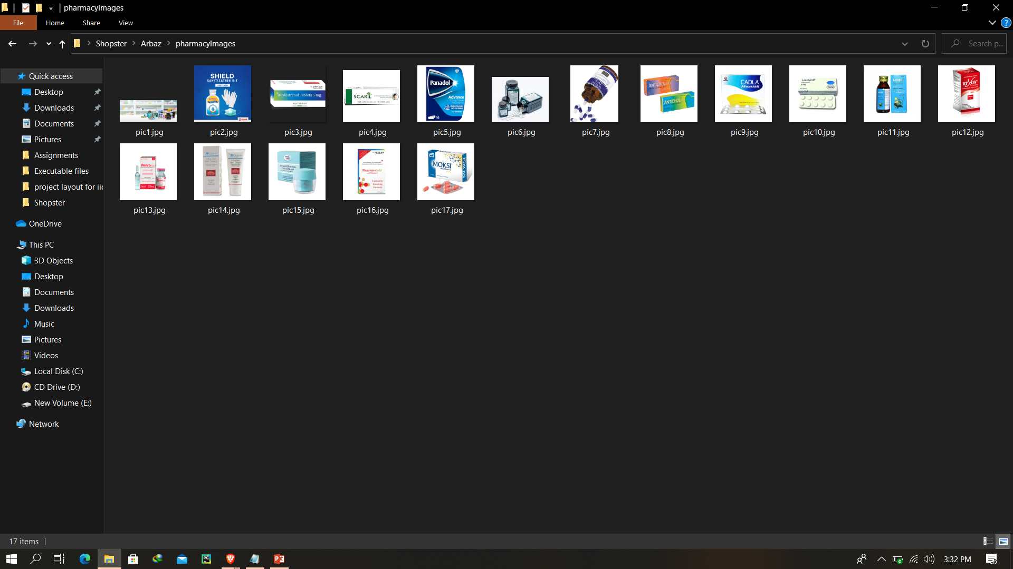
Arbaz Images Folder (Pharmacy)

Slide 35
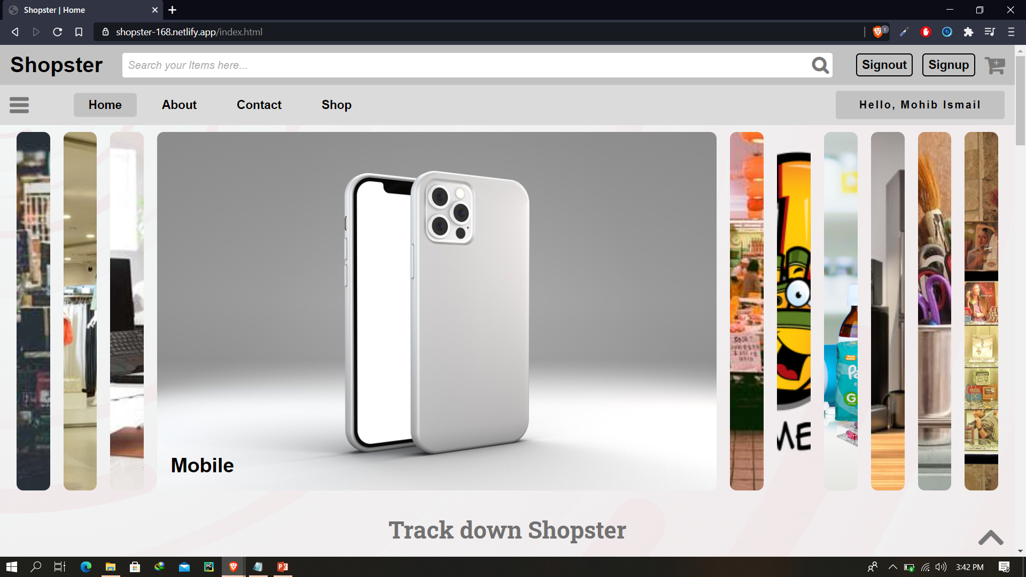
Home page

Slide 36
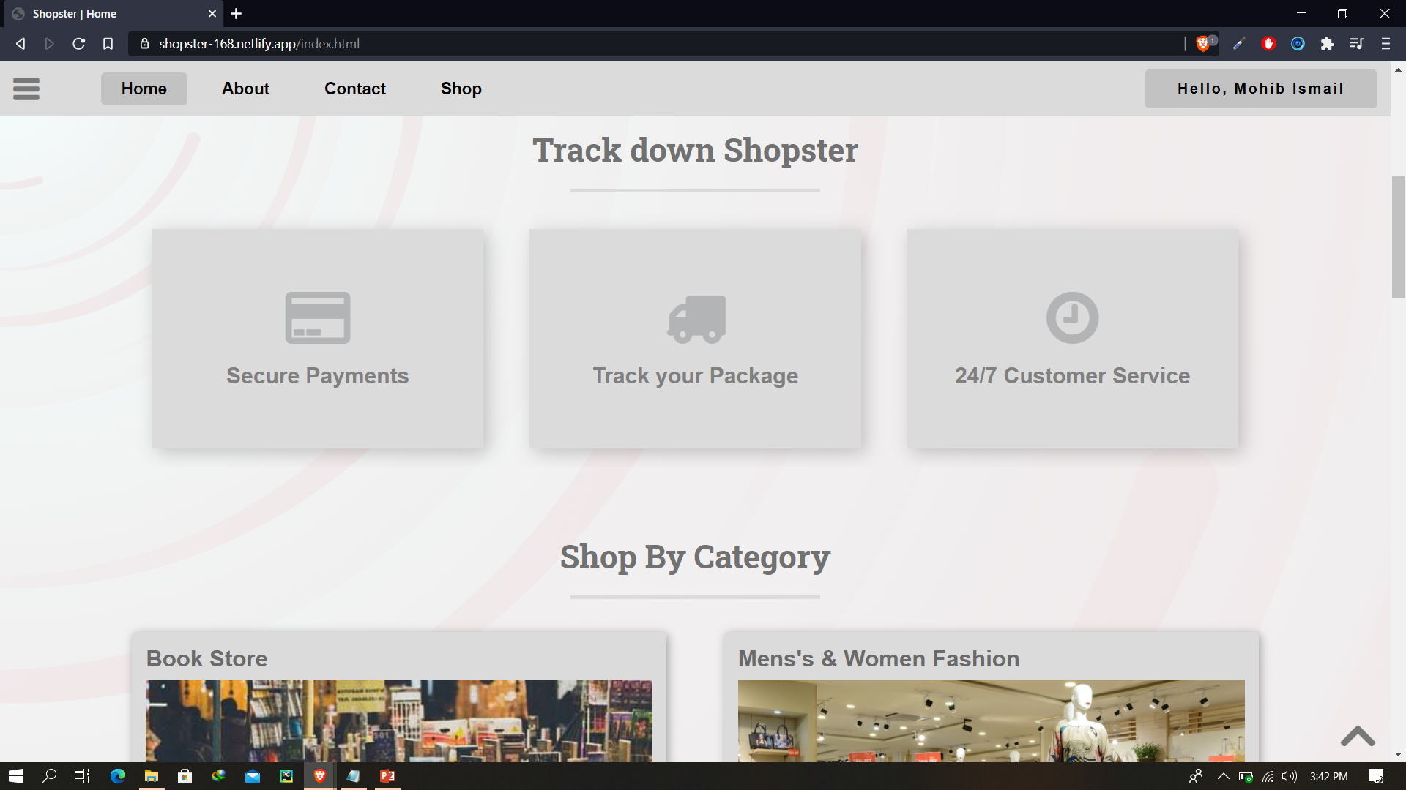
Home page (Cont)

Slide 37
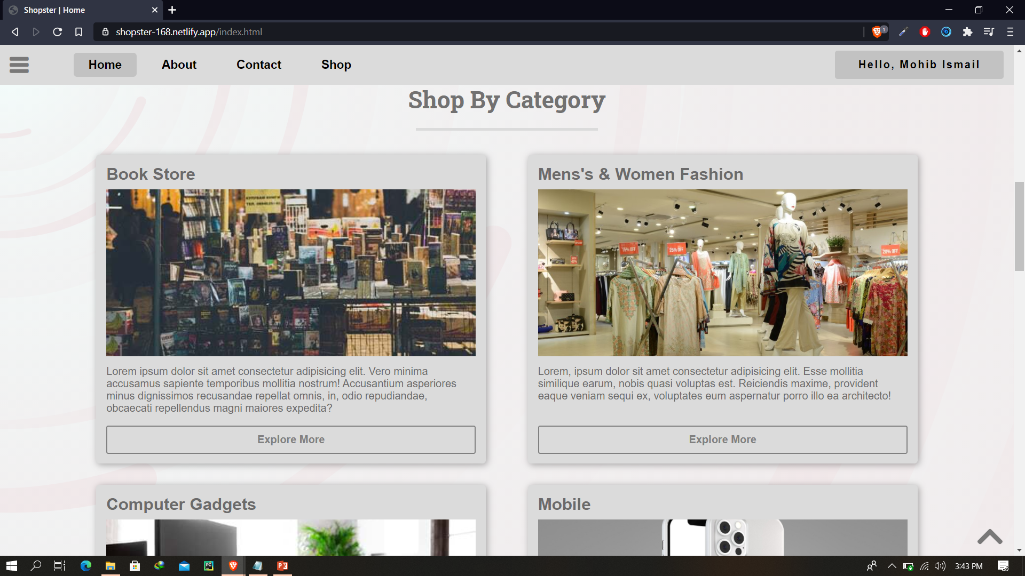
Home page (Cont)

Slide 38
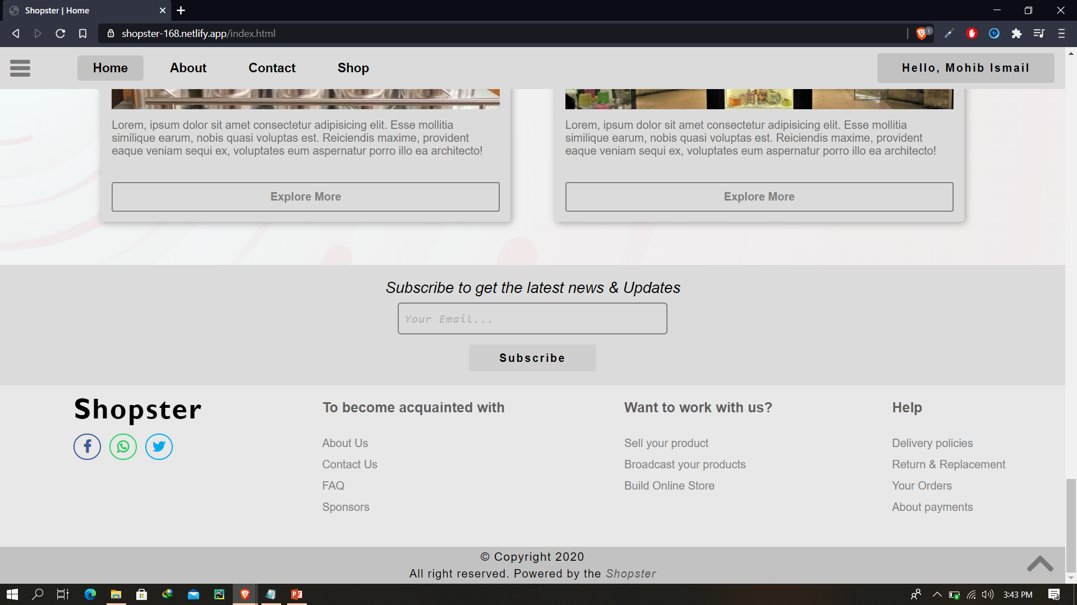
Home page (Cont)

Slide 39
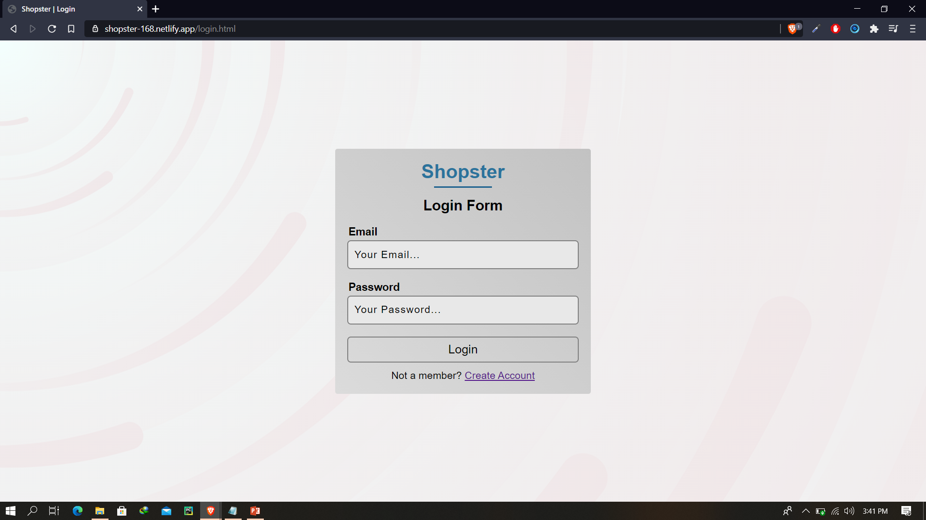
Login Page

Slide 40
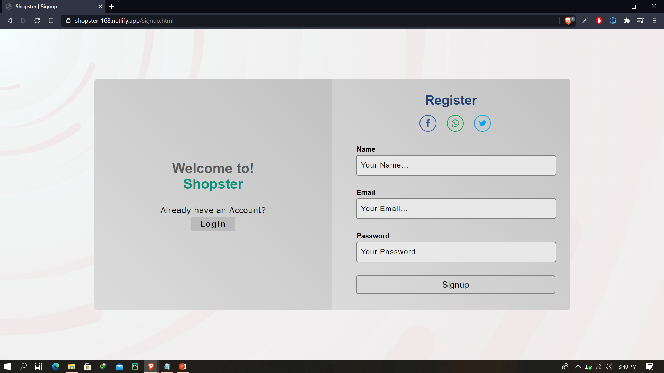
Signup Page

Slide 41
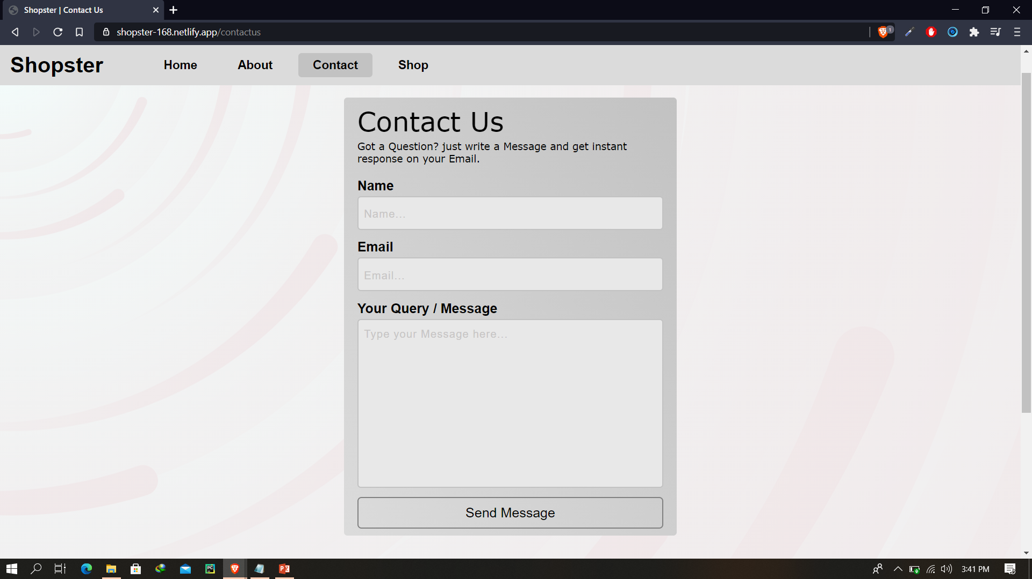
Contact Us page

Slide 42
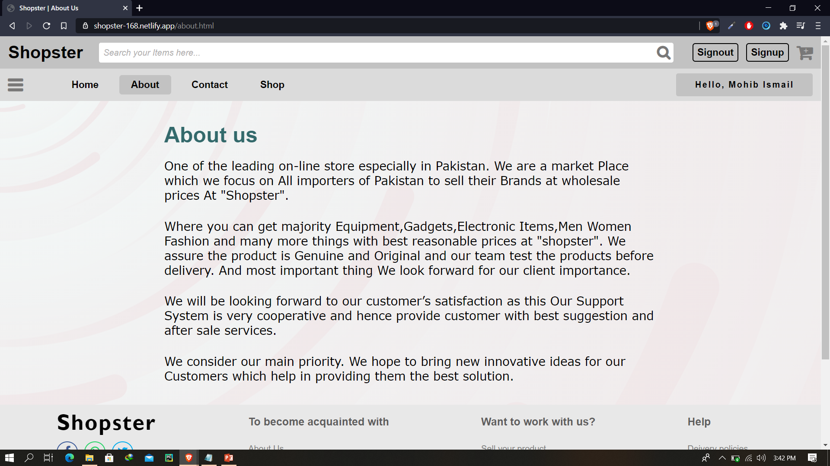
About Us page

Slide 43
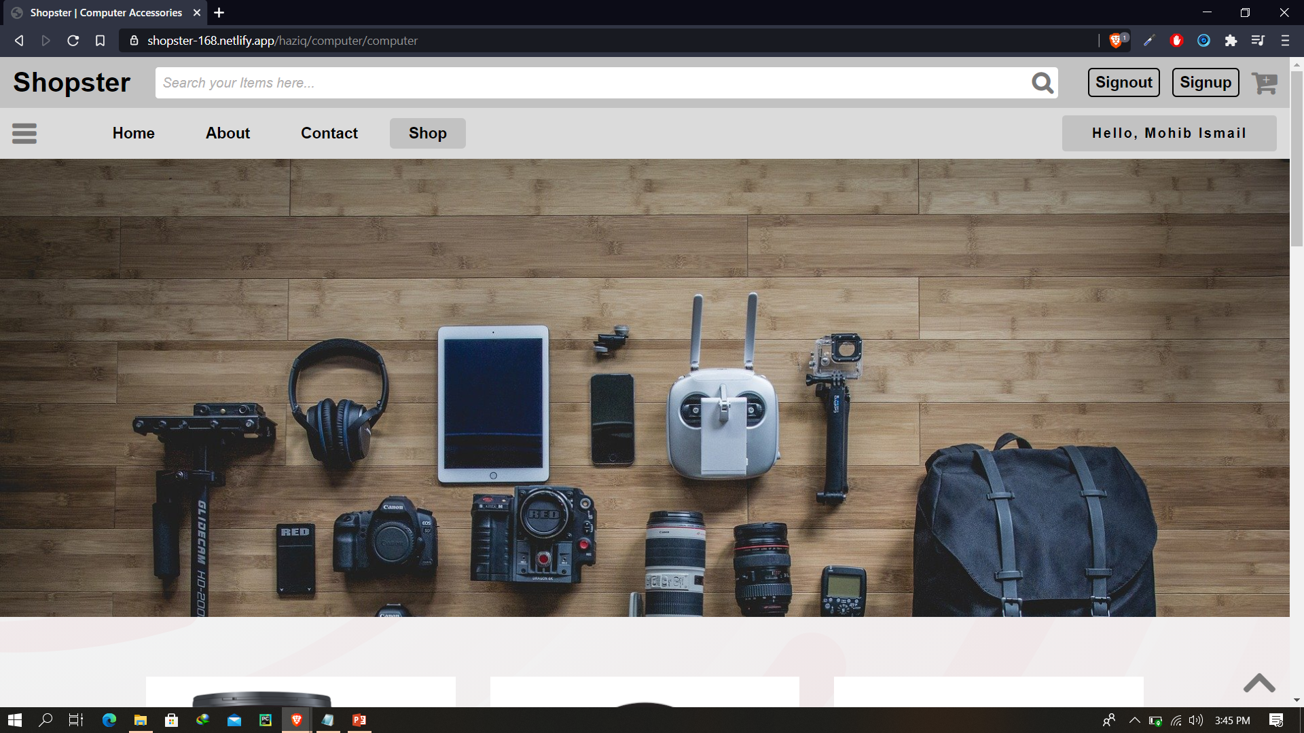
Category Page By Haziq

Slide 44
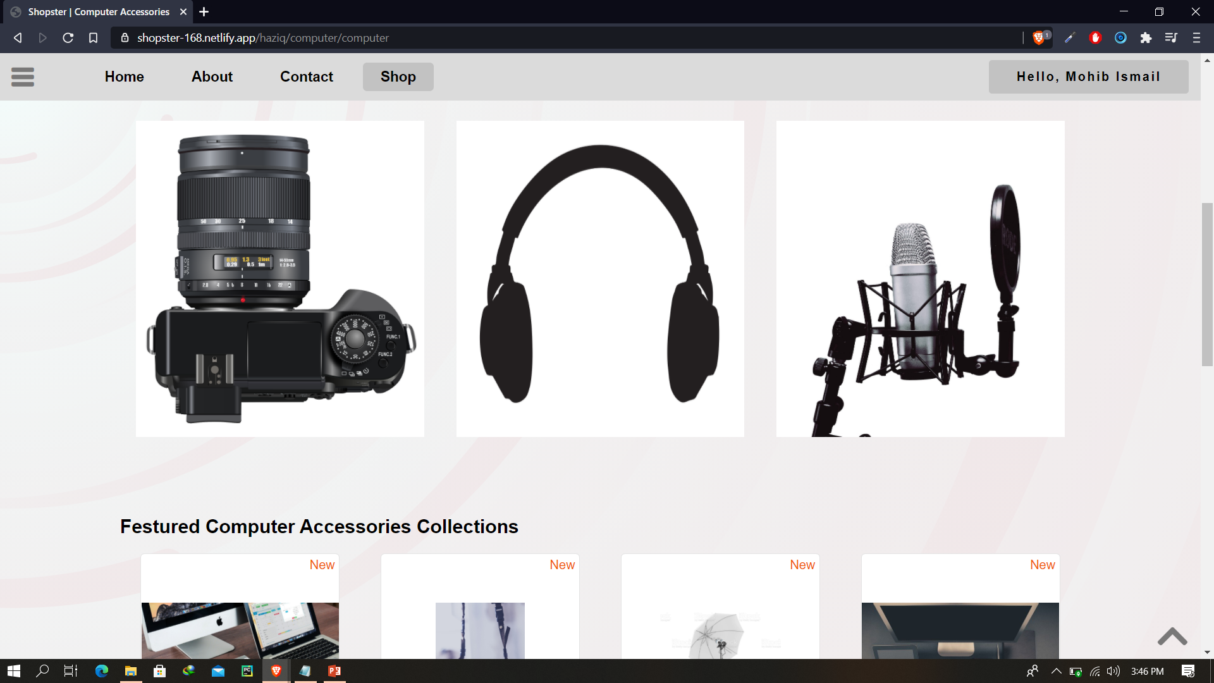
Category Page By Haziq (Cont)

Slide 45
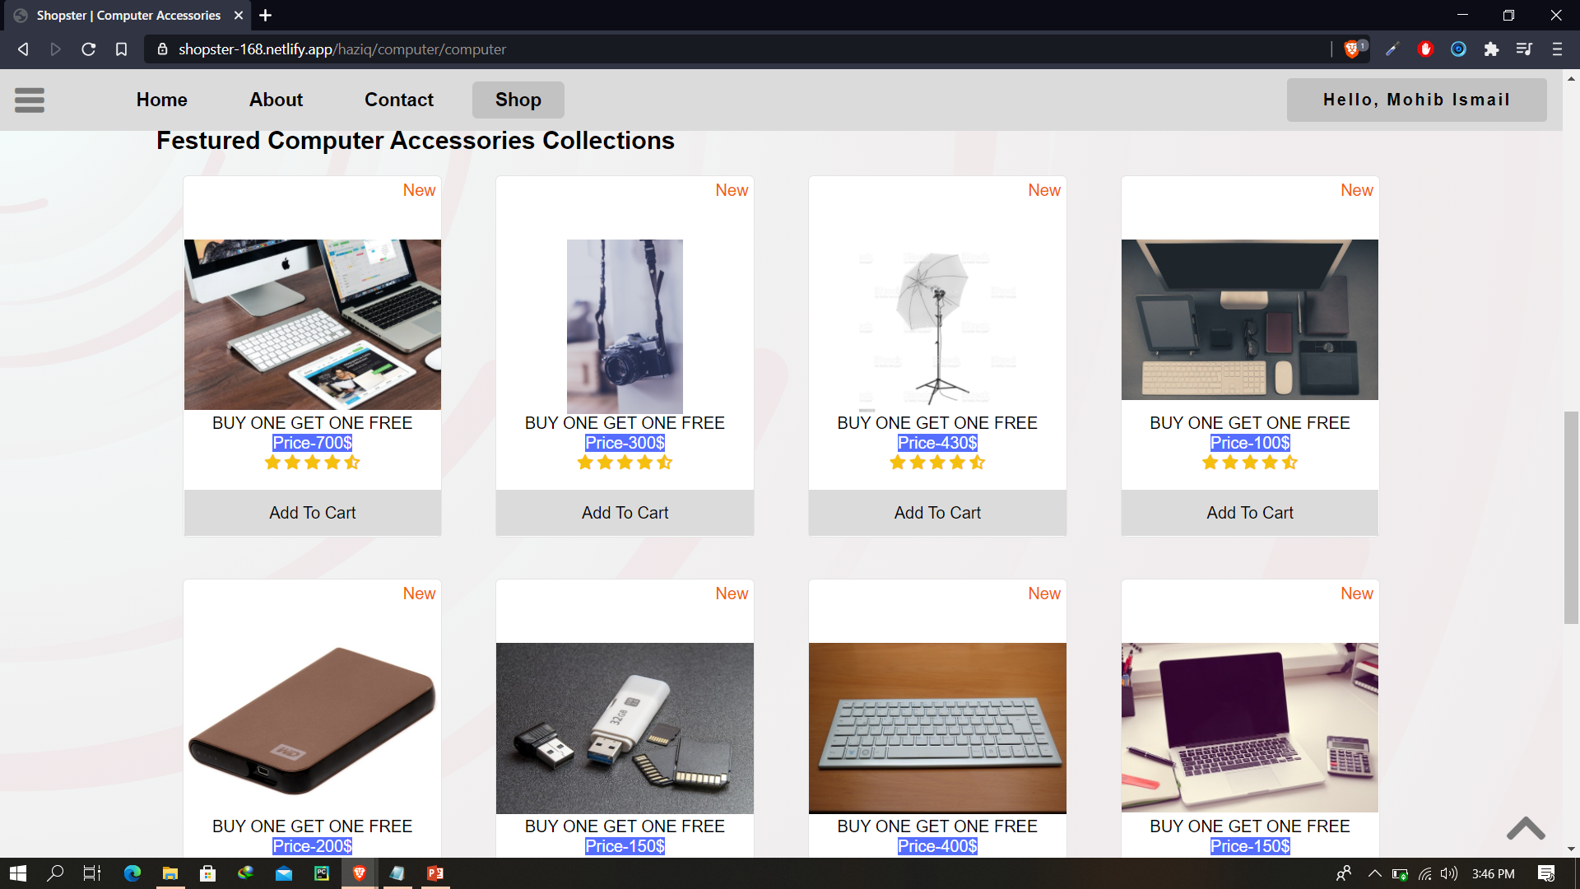
Category Page By Haziq (Cont)

Slide 46
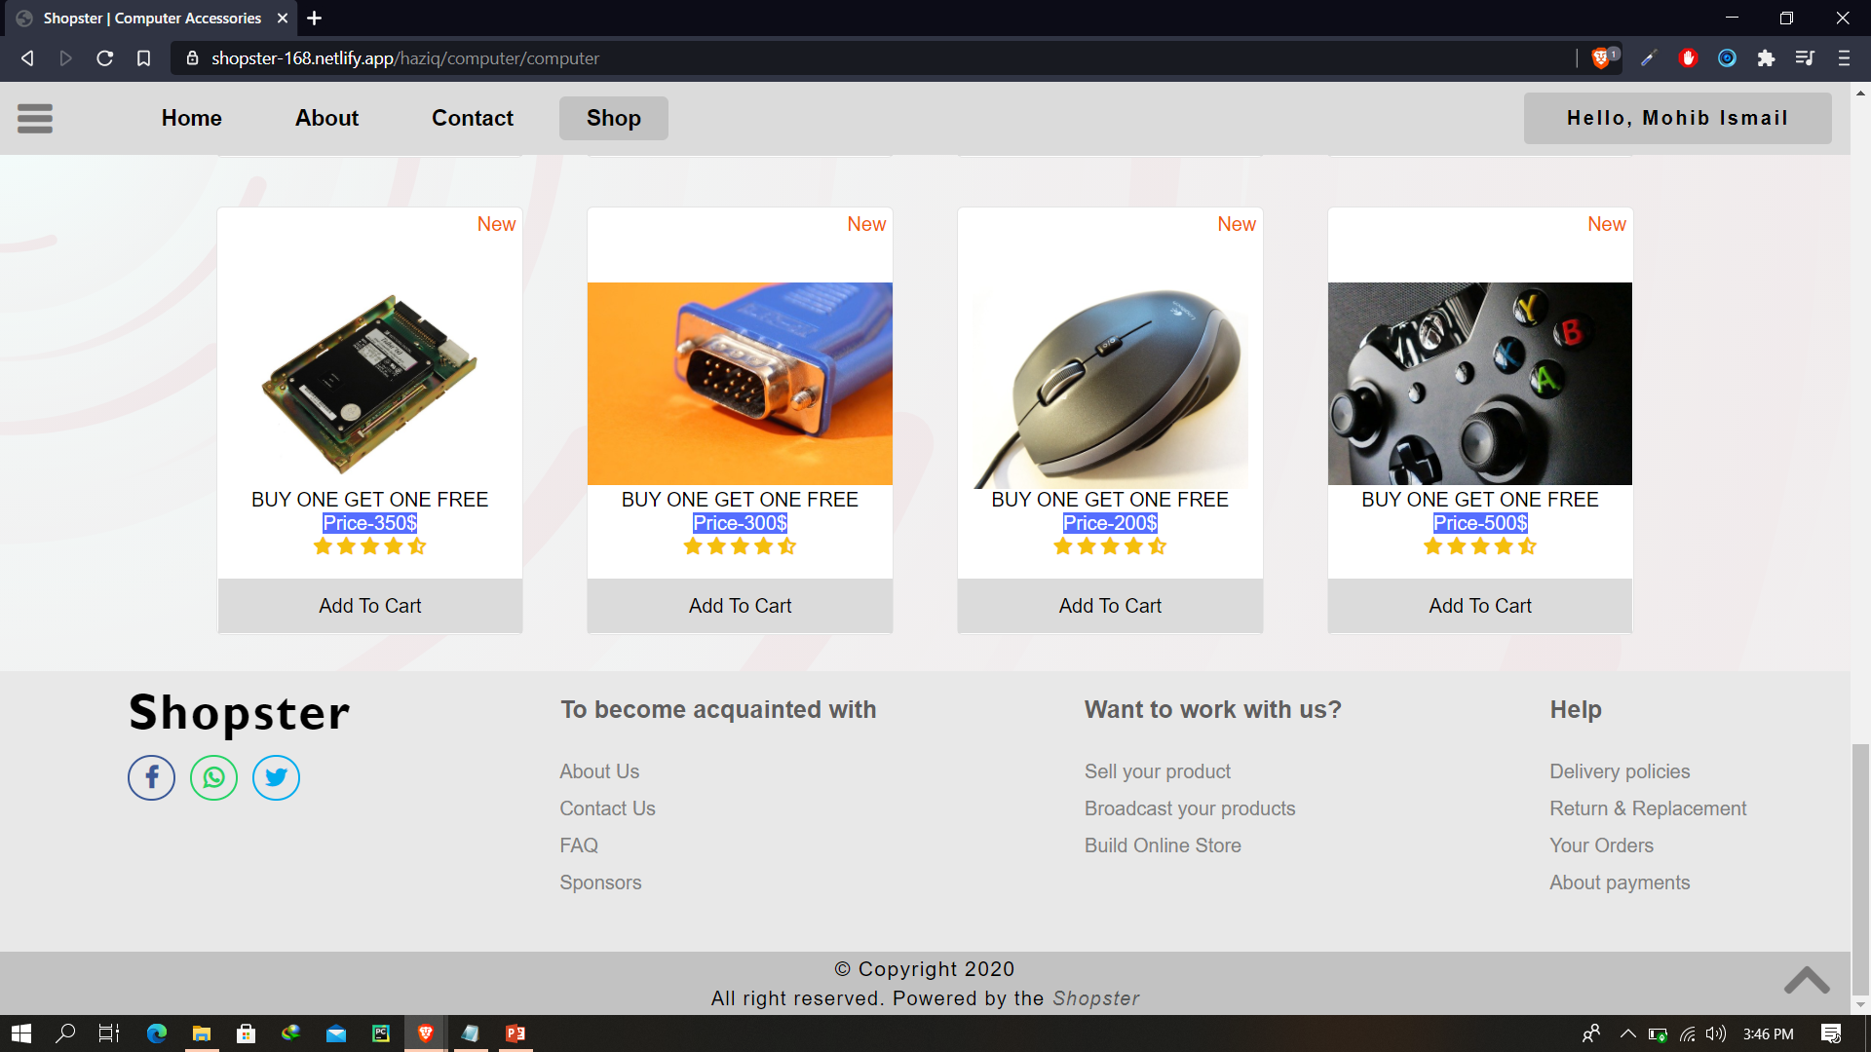
Category Page By Haziq (Cont)

Slide 47
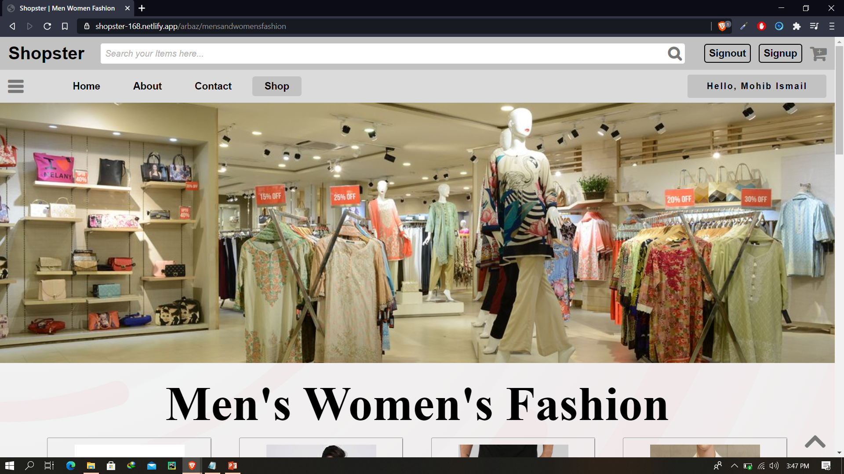
Category page By Arbaz

Slide 48
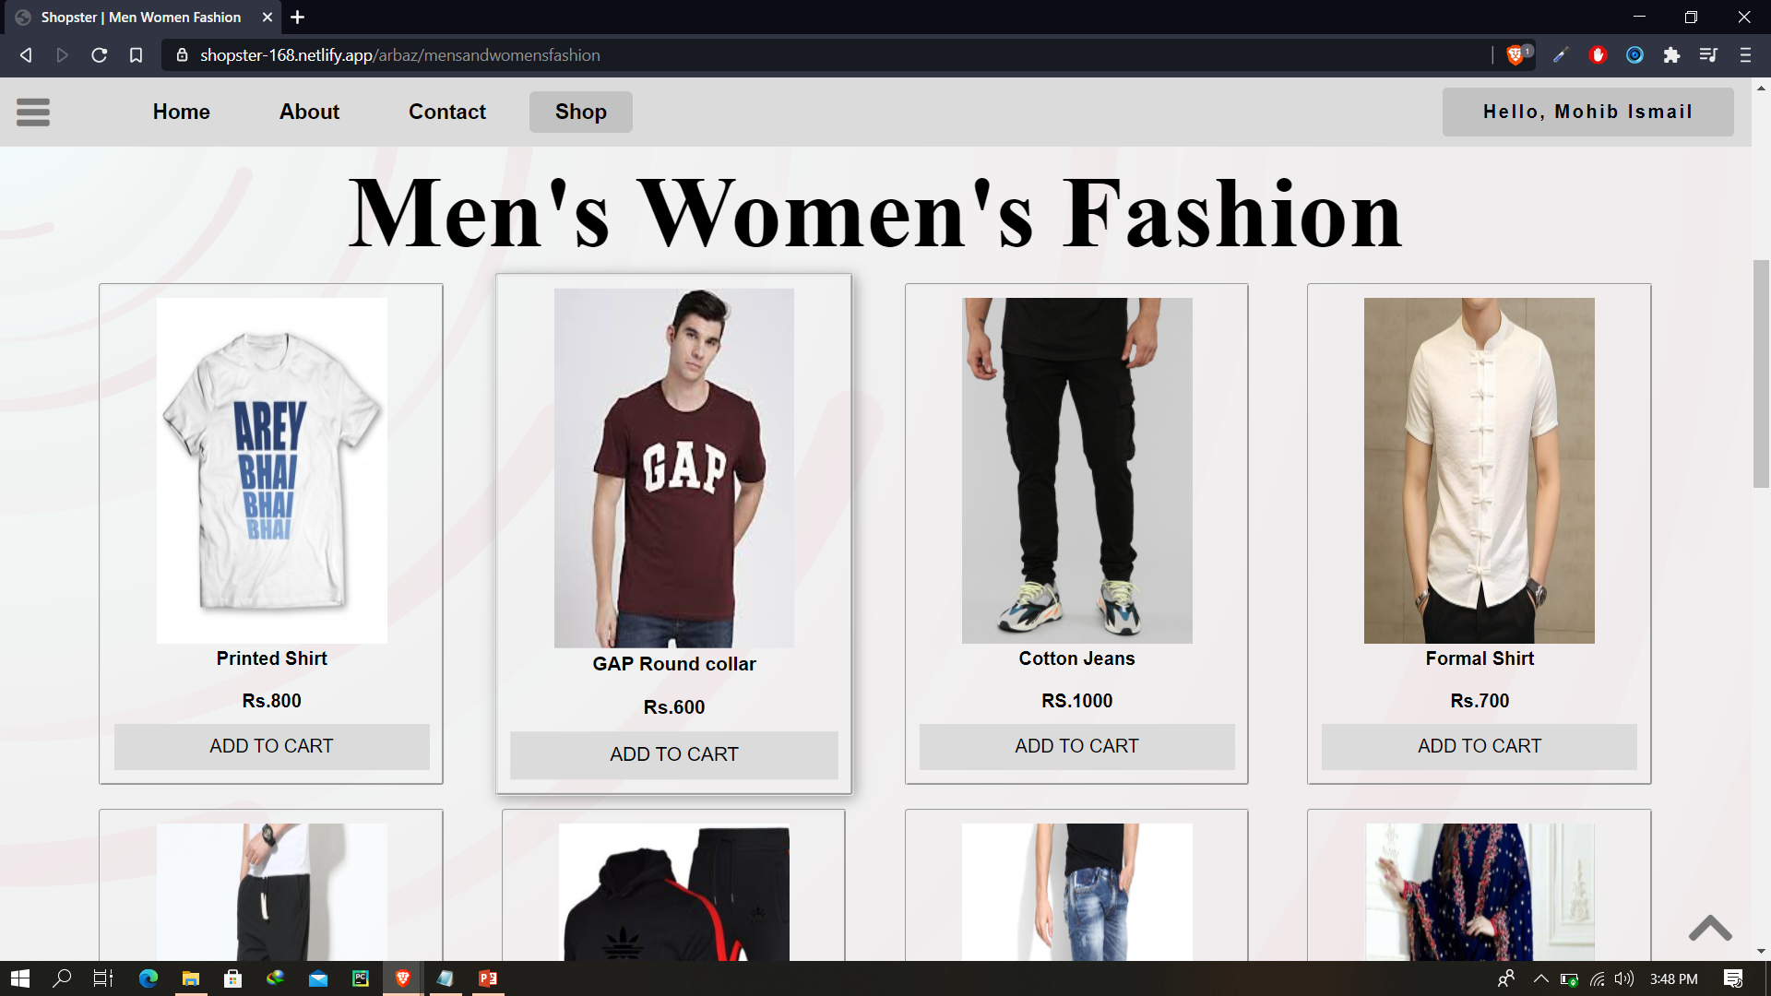
Category page By Arbaz (Cont)

Slide 49
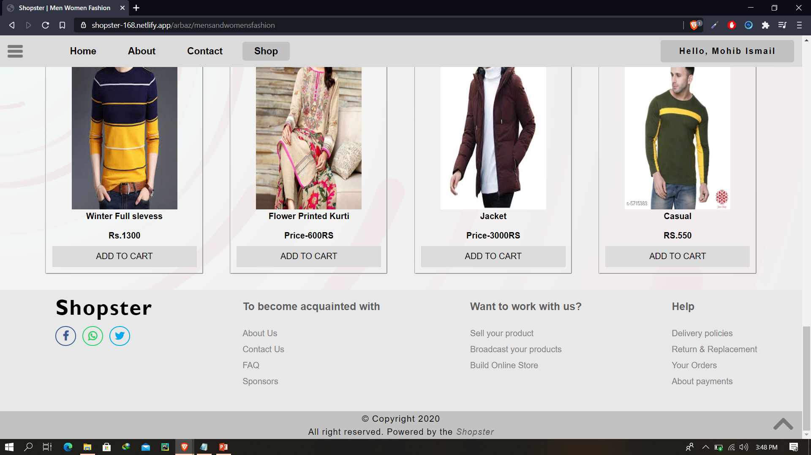
Category page By Arbaz (Cont)

Slide 50
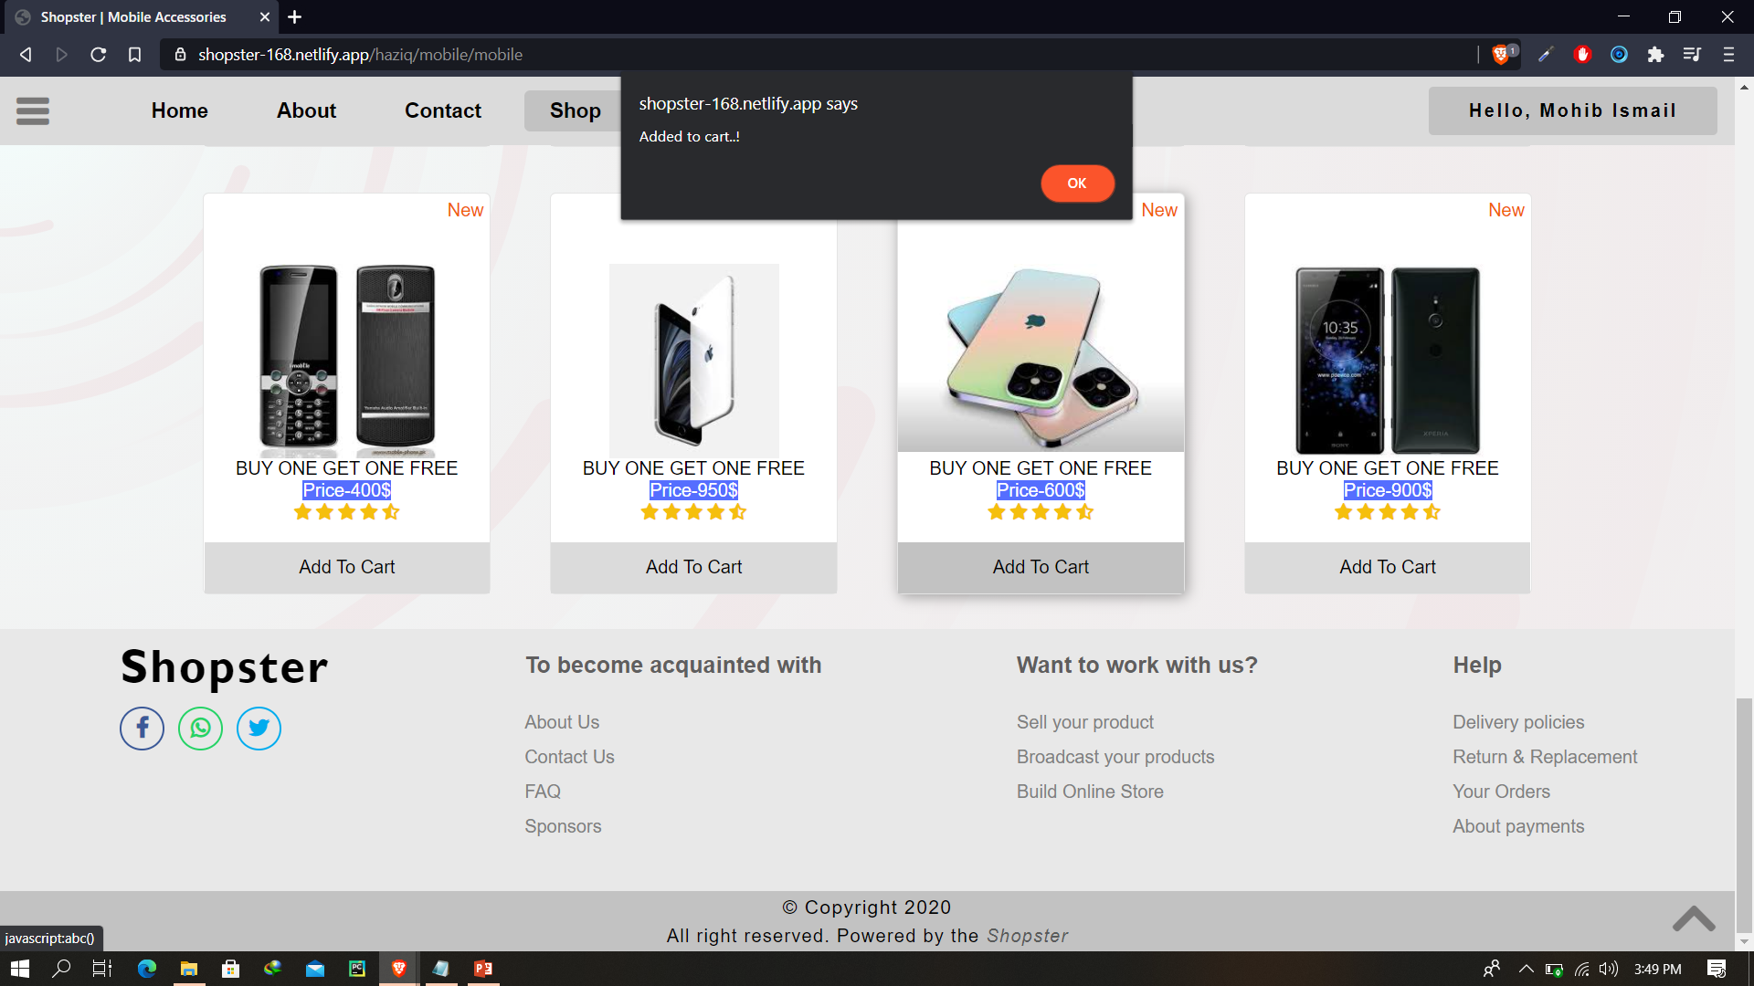
Add to Cart

Slide 51
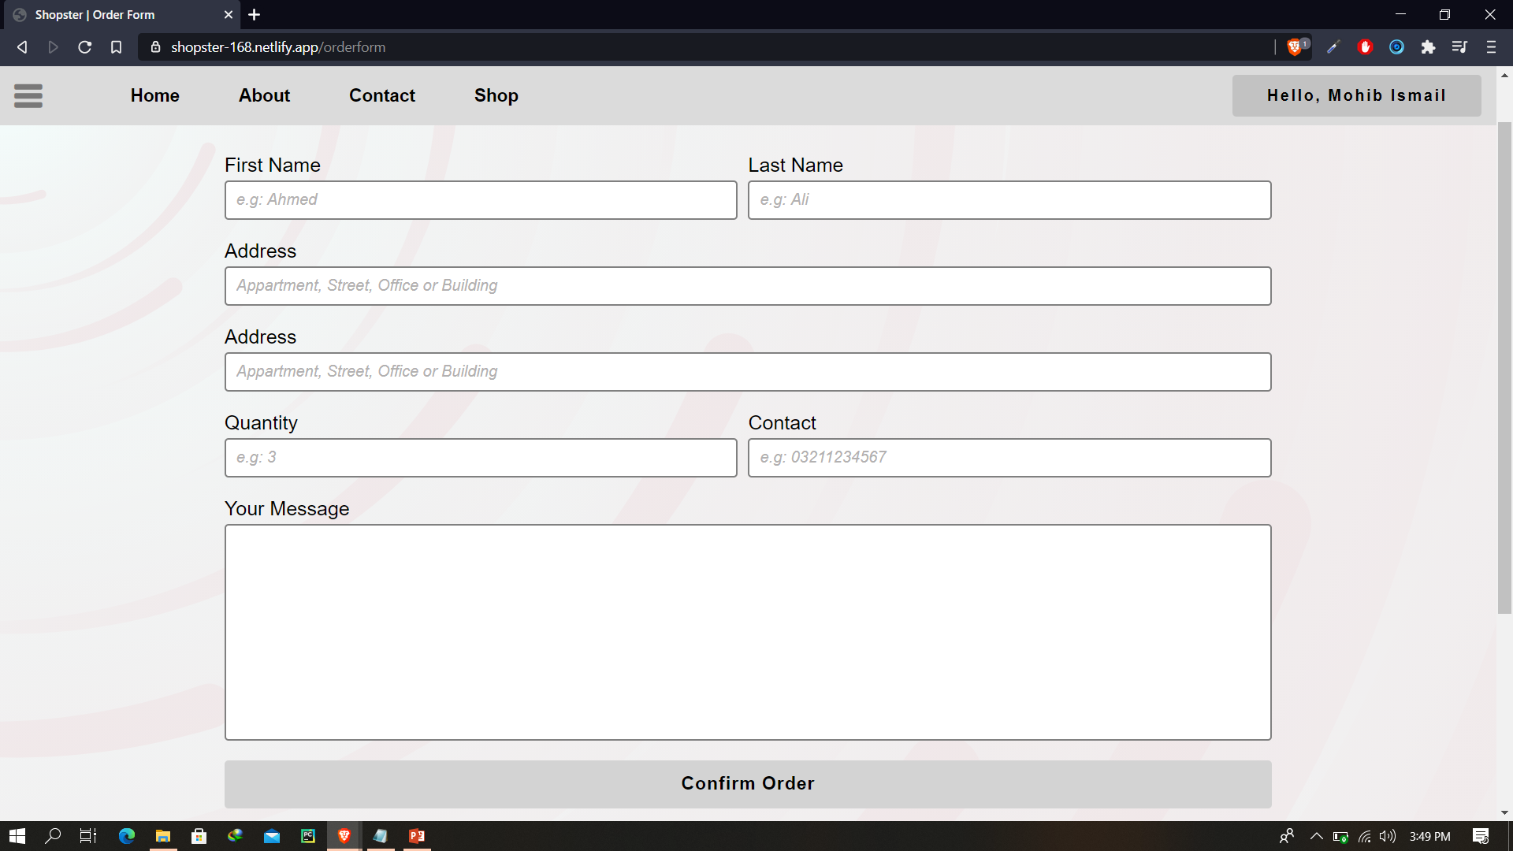
Order Form By Mohib

Slide 52
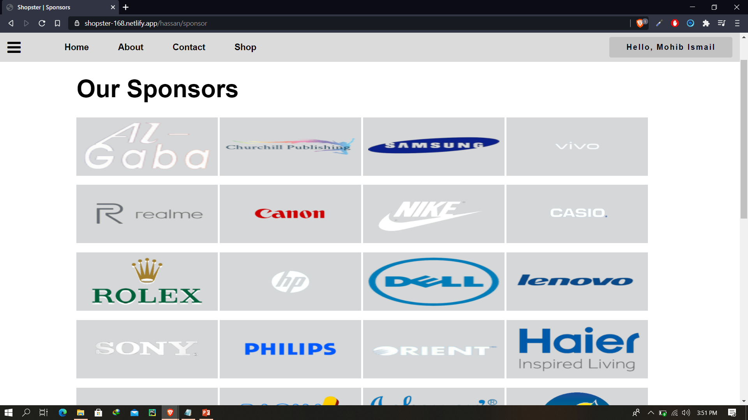
Sponsors Page

Slide 53
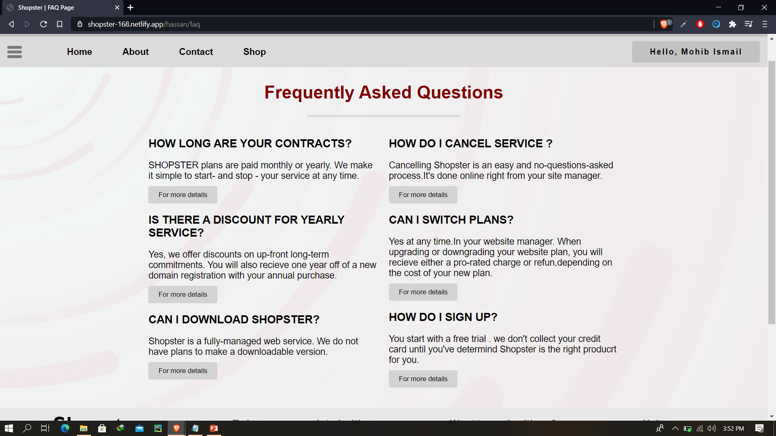
FAQ page

Slide 54
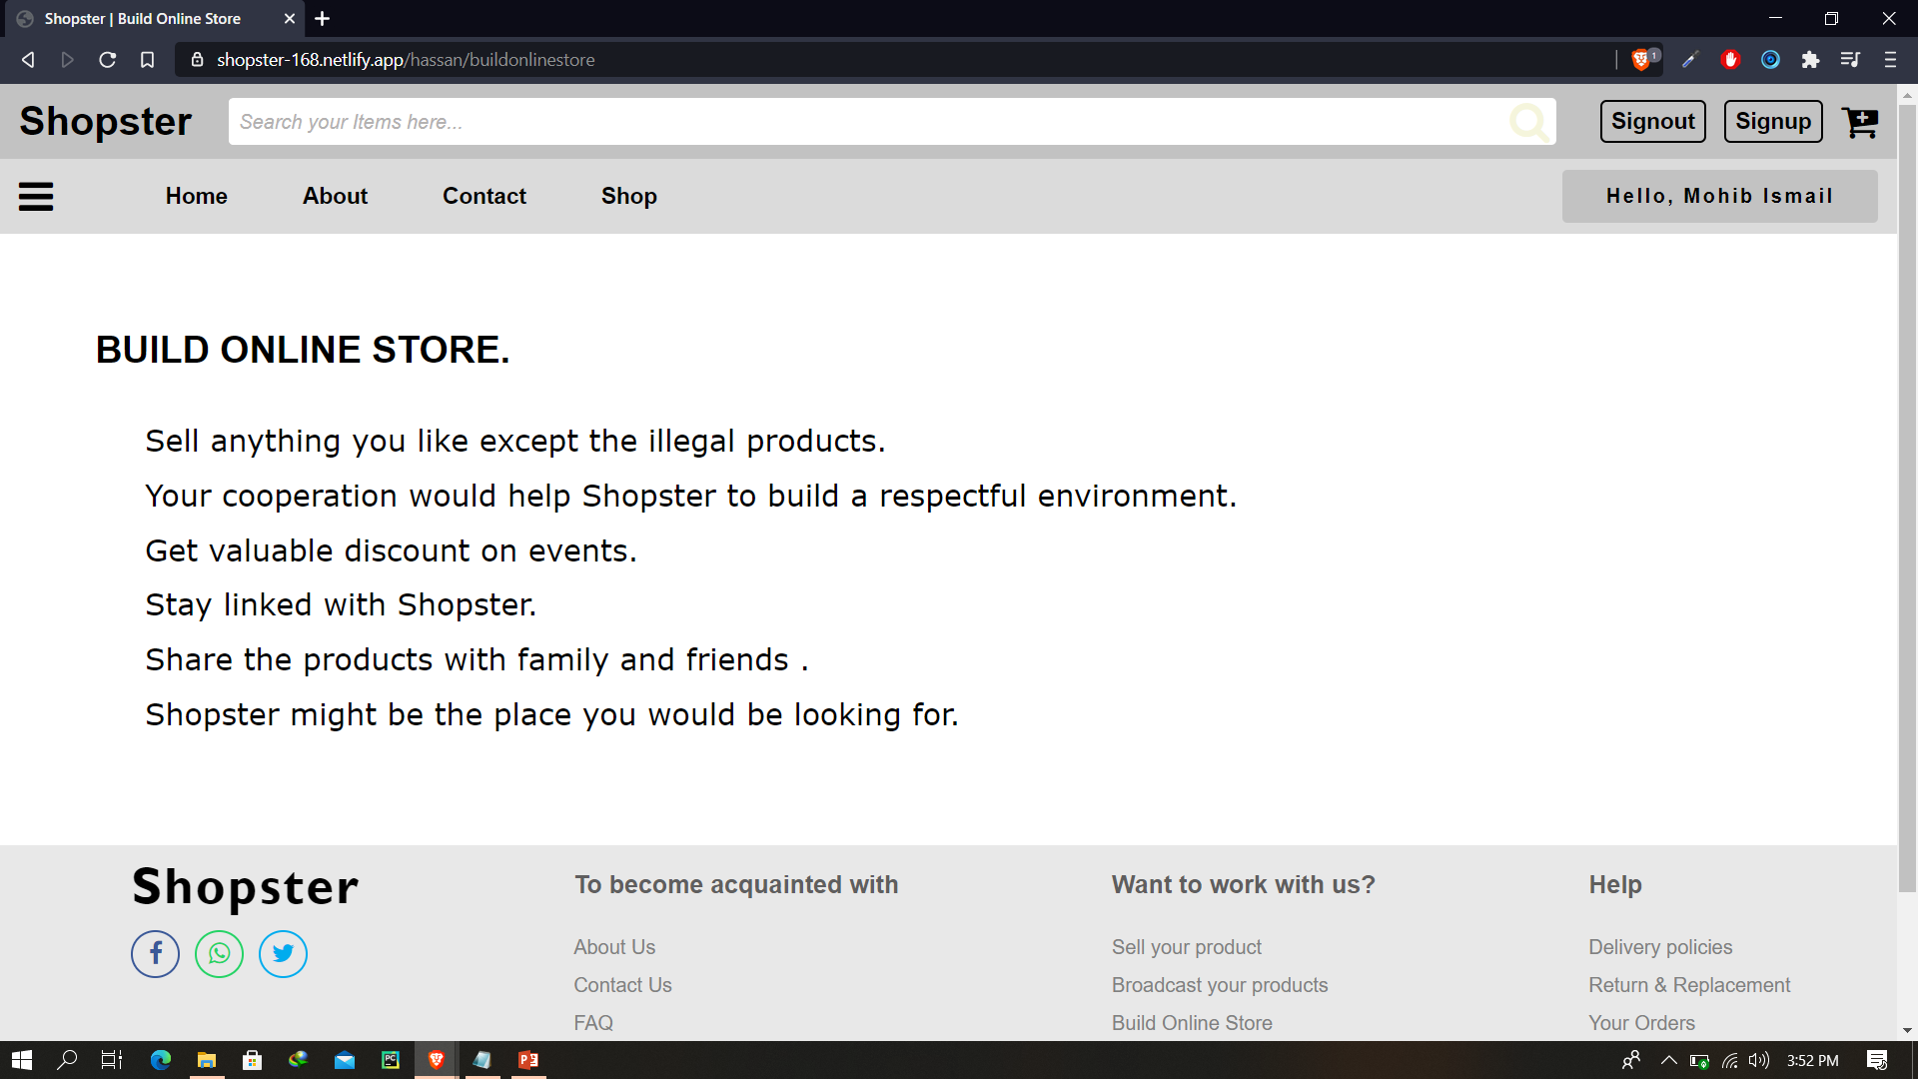
Build Online Store page All the other pages on the footer is done with same design

